Slide 1
Building apps for Microsoft SharePoint and OneDrive
Integrate and extend with your application experience
Version 1.0

Slide 2
Agenda
Microsoft SharePoint and OneDrive Overview and Opportunity
Extensibility scenarios
Files
Lists
SharePoint Framework (SPFX)
Deployment and Configuration
Open Source

Slide 3




OneDrive
Team sites
Intranet Sites
Portals
Portals\Lists integration Power Apps & Power Automate
Share and work together
Inform and engage people
Harness collective knowledge
Transform business processes
Extend & develop

Slide 4

Microsoft 365 Extensibility Foundation
Office Apps
SharePoint
Create & co-author documents
Pages & content management
Azure AD & Office 365 Groups
Identity & Membership
Outlook
Teams
Email & calendar
Microsoft Graph
Hub for teamwork
Data & Intelligence
Microsoft 365 Trust
Security & Compliance
OneDrive
Automation
All your files, anywhere
Integrated processes
Windows 10
Rich user experiences

Slide 5
SharePoint & OneDrive functional design
3rd Party Web Extensibility
SharePoint Framework – SPFx \ File Handlers
1st Party Apps
OneDrive \ Teams \ Office \ etc.
3rd Party Apps
DLP \ Search \ Files \ Lists \ Photos
Data Bound Controls
OneDrive Consumer
Web Templating
SharePoint Home, Team Sites, Comm Sites, ODB, etc.
API Surface (Graph \ REST \ CSOM)
Graph \ REST
Tenant\Site Collection abstraction
User Abst
Files CRUD
+ Services
Lists CRUD
+ Services
Web Pages CRUD
+ Services
Files CRUD
+ Services

Slide 6
Files extensibility scenarios
An overview of the extensibility options when working with files in SharePoint and OneDrive

Slide 7
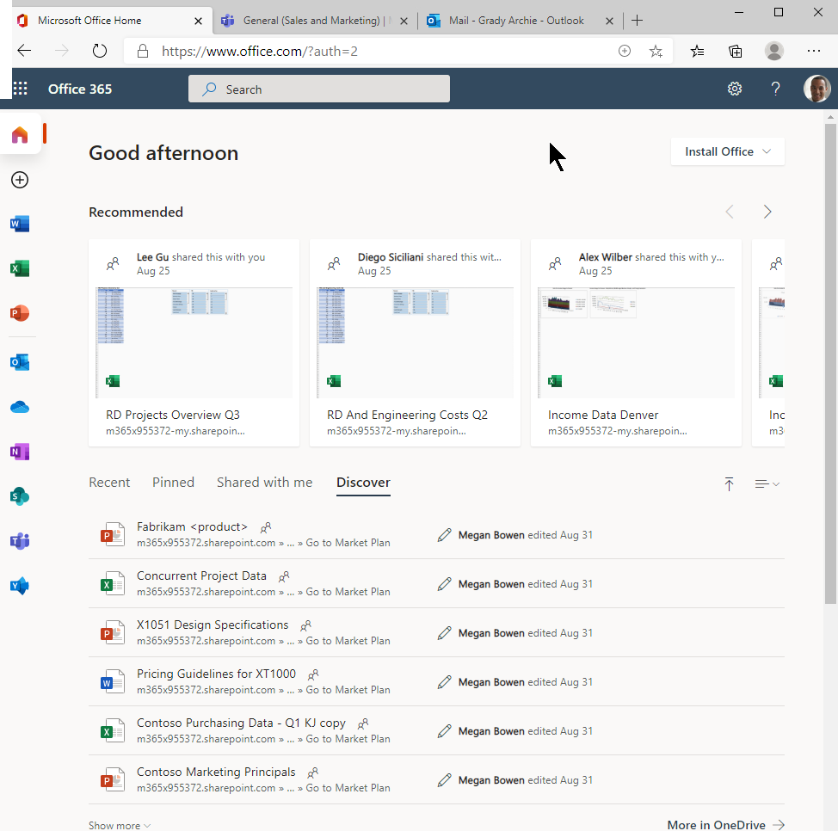
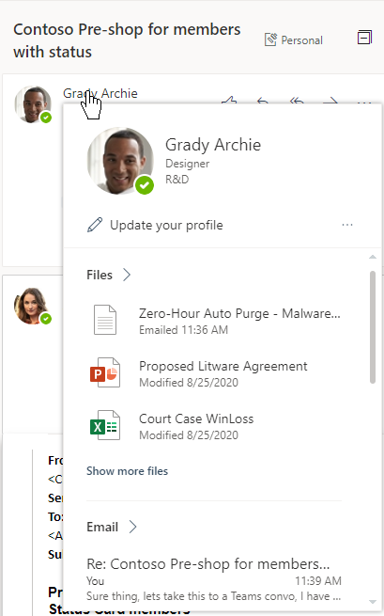
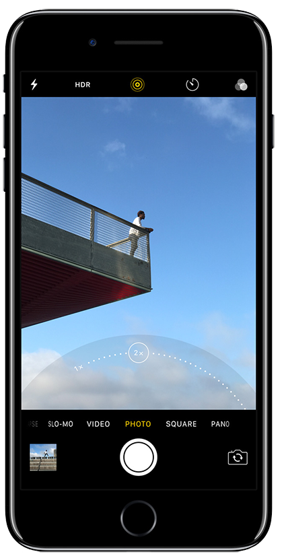
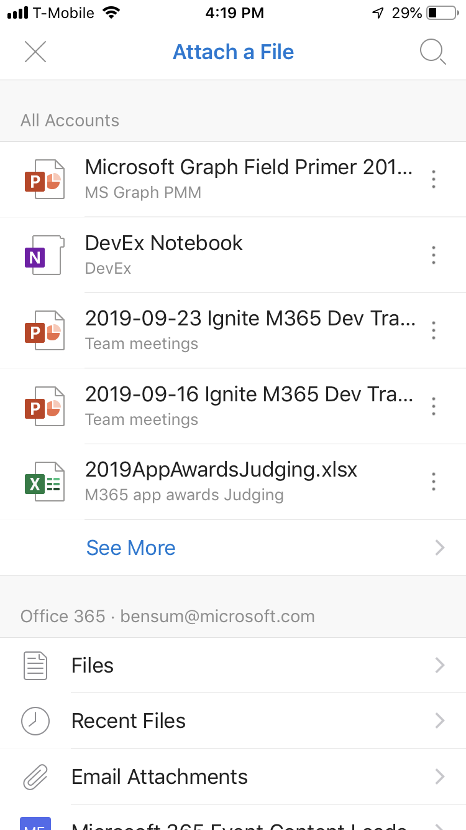
Files
File Preview
No additional infrastructure for hosting
Maintain a focus on your App while we do the rest
Government and Industry compliant

Slide 8
Turbocharged SharePoint file storage Fast, phenomenal, and fluid
10X
3X
30x
320+
faster downloads
performance
faster indexing
file types
AI-POWERED INSIGHTS
INTELLIGENT SECURITY
INNOVATIVE EXPERIENCES

Slide 9

Viewing, selecting and uploading files
Deep integration via API’s
Owning my file types

Slide 10
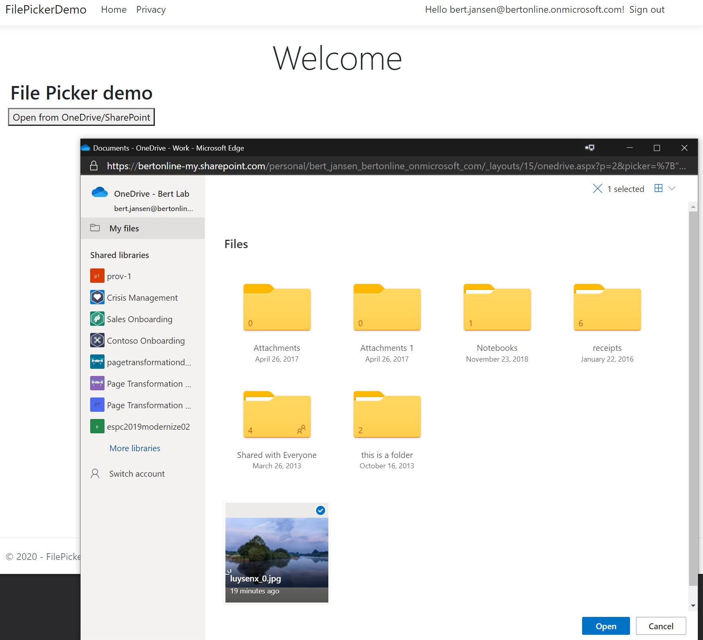
Selecting files
Control allowing file browsing and picking
File Open mode: allows for file downloads via direct download link, file id’s (for API access) or read-only sharing link
Implementation:
JavaScript library: https://js.live.net/v7.2/OneDrive.js
Resources:
Documentation
ASP.Net Core sample
SPFX sample
A new picker experience is in progress

Slide 11
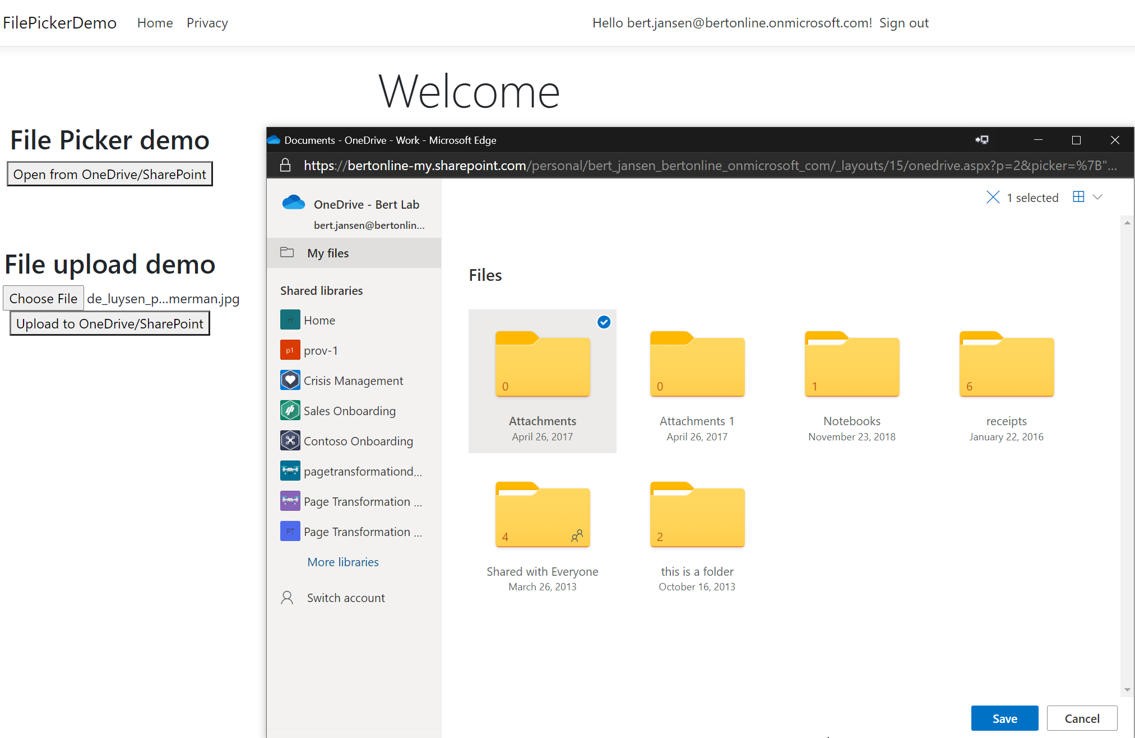
Uploading files
Control allowing file browsing and uploading
File Save mode: file upload via direct upload or upload location id’s (for API access)
Implementation:
JavaScript library: https://js.live.net/v7.2/OneDrive.js
Resources:
Documentation
ASP.Net Core sample
A new picker experience is in progress

Slide 12
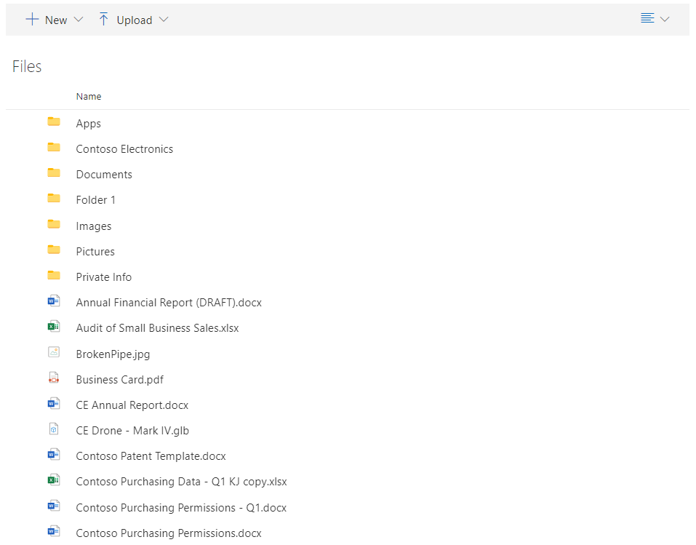
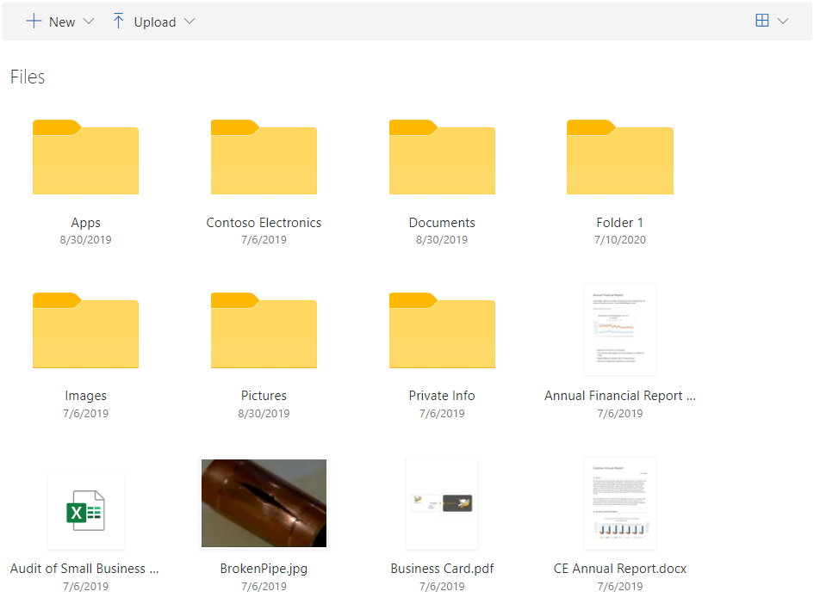
Browsing files (soon)
Embed a browsing control in your application that works similar as the browsing files in Microsof’s products like Office, SharePoint and Teams
Coming soon!

Slide 13
Viewing, selecting and uploading files
Deep integration via API’s
Owning my file types

Slide 14
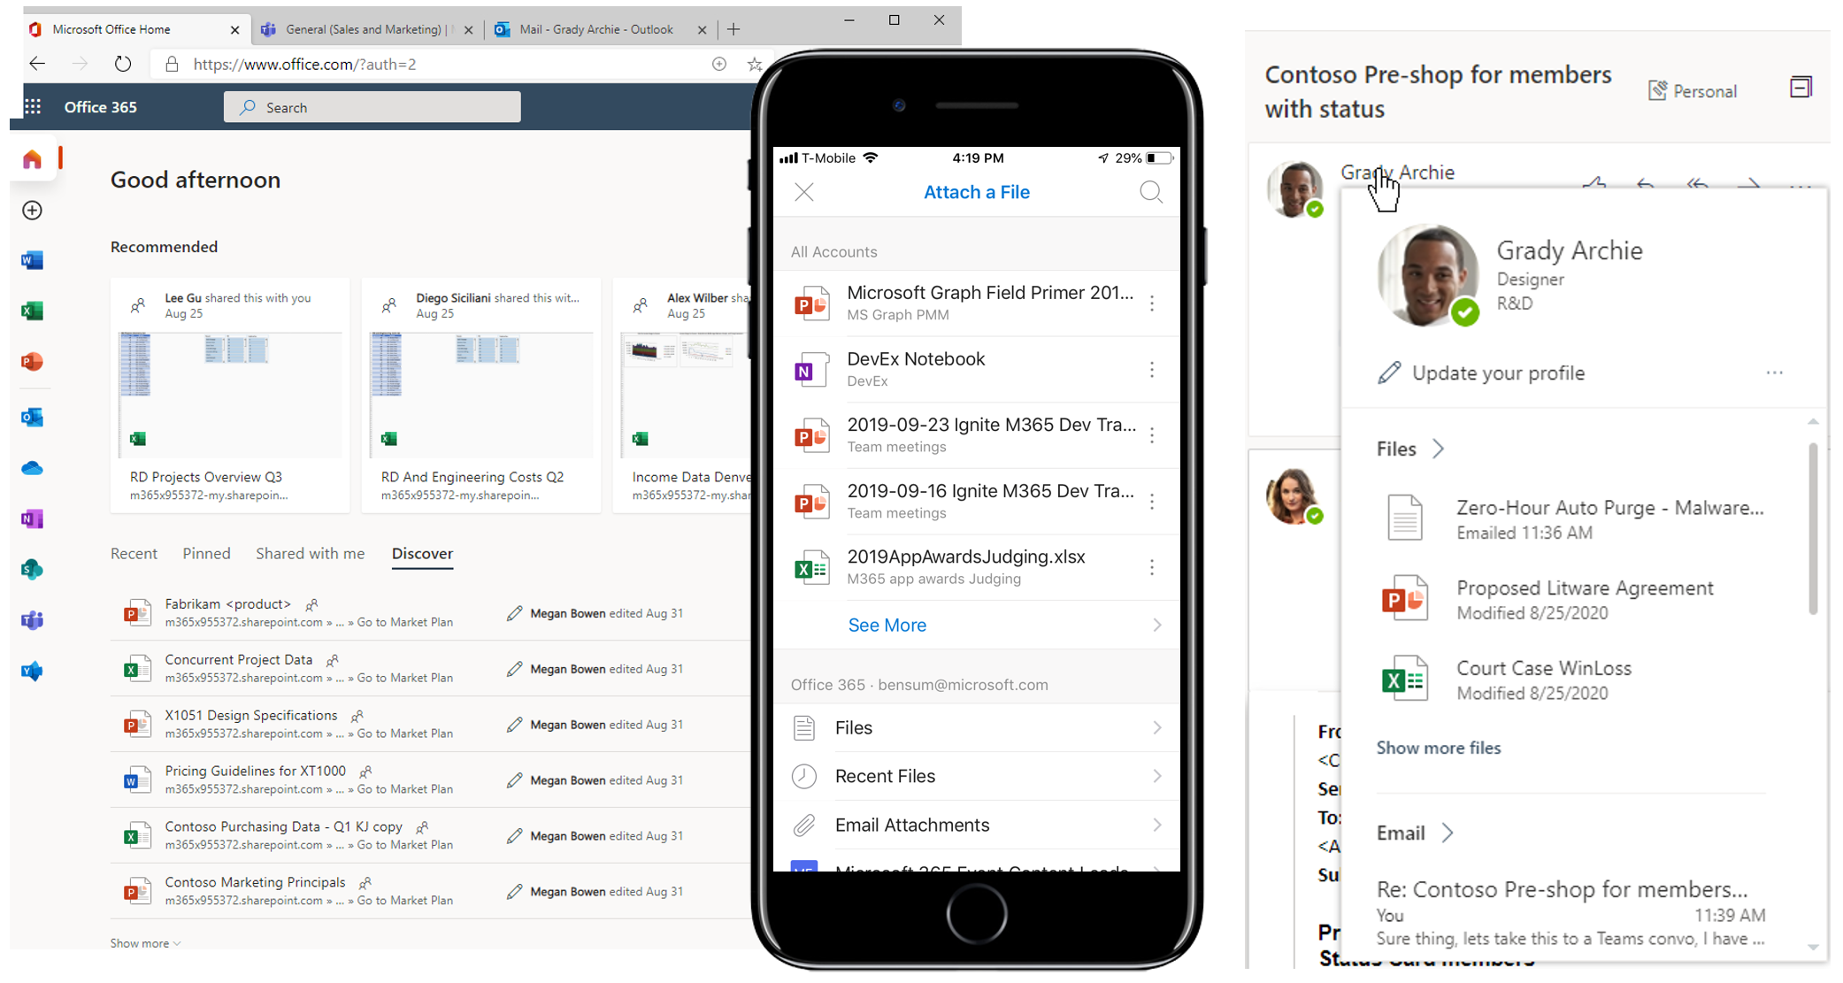

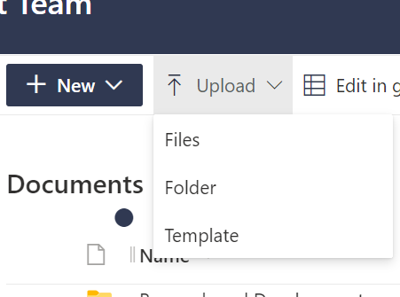
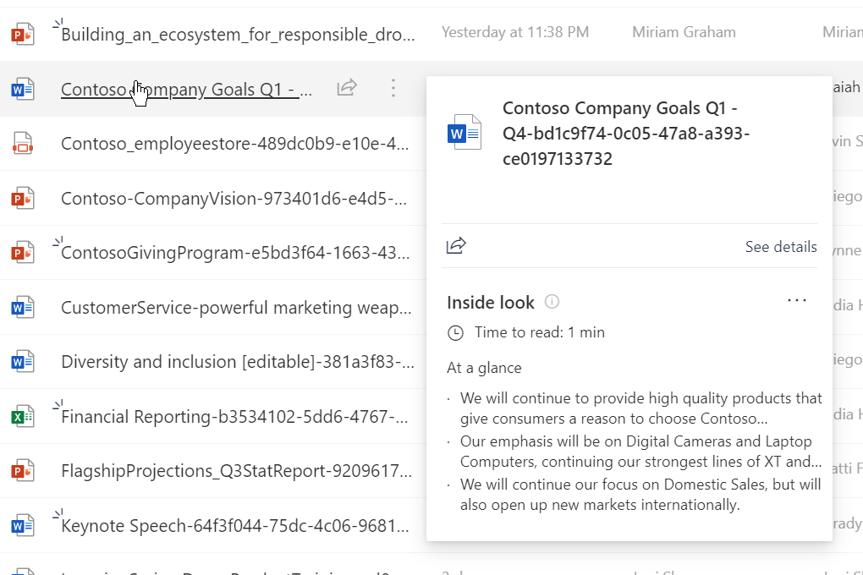
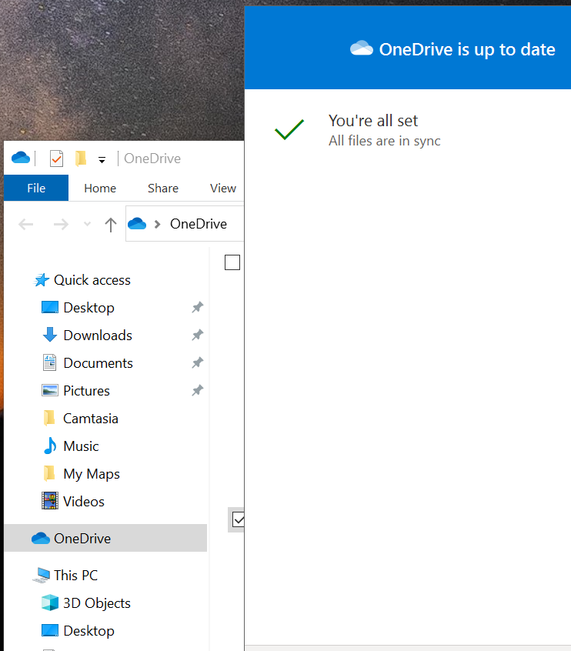

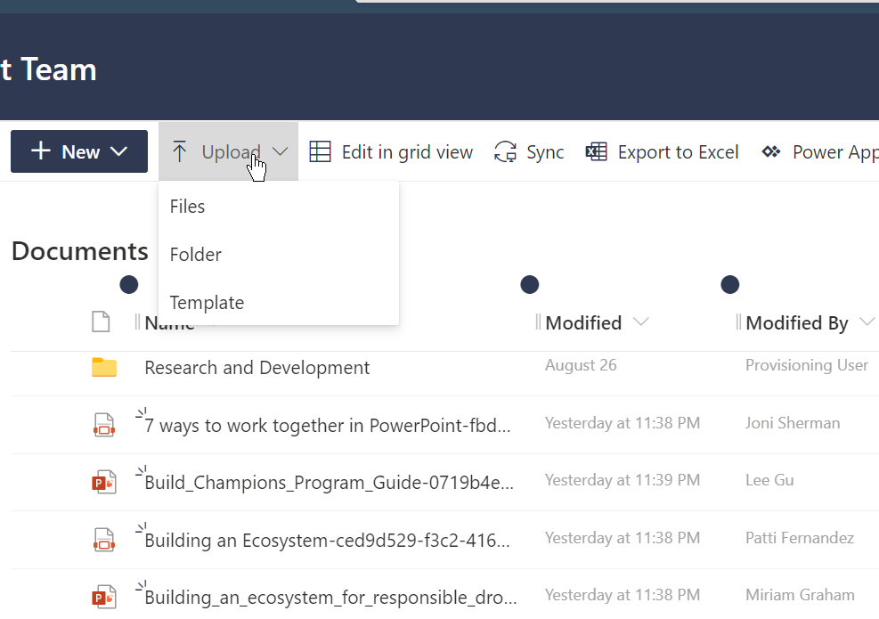
Single Source for Personal and Corporate Data
Files (drive/drive item) represents an item within a drive, like a document, photo, video, or folder
/v1.0/me/drive
/v1.0/sites/{id}/drives
/V1.0/sites/{id}/drive/items/{id}
/v1.0/groups/{id}/drive
Microsoft Graph
Use in a File Picker
Native File Viewing
Integrated Search Exp.
Doc Gen & Save
Native File Syncing

Slide 15
Basic Microsoft Graph elements
Sites – Contains lists, drives, and subsites
/v1.0/sites/{site-id}
Drive – Contains files and folders
DriveItem – A file or folder that is in a Drive
/v1.0/sites/{siteId}/drive/items/{item-Id}

Slide 16

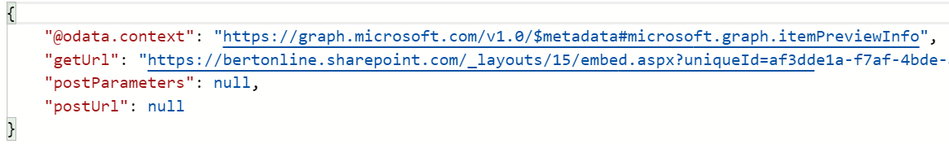
File Previews
Graph API to get previews of 320+ file types
Resources:
Graph documentation
ASP.Net Core sample
v1.0/me/drive/items/{id}/preview
v1.0/sites/root/drives/{drive-id}/
items/{id}/preview

Slide 17

File Thumbnails
Graph API to get thumbnails of 320+ file types
Resources:
Graph documentation
ASP.Net Core sample
v1.0/me/drive/items/{id}/thumbnails/
0/large/content
v1.0/sites/root/drives/{drive-id}/items/{id}/thumbnails/
0/large/content

Slide 18
Subscriptions and Delta queries
Microsoft Graph based web hooks that you can use to be notified of events
Delta queries to just get the changes since last time
Resources:
Subscriptions documentation
Delta query documentation

Slide 19
Scan guidance
Best practices for discovering files and detecting changes at scale
Continuously crawling all SharePoint content is not recommended, being notified of changes is a much better pattern
Documentation:
aka.ms\scanguidance
aka.ms\deltadoc

Slide 20
Viewing, selecting and uploading files
Deep integration via API’s
Owning my file types

Slide 21
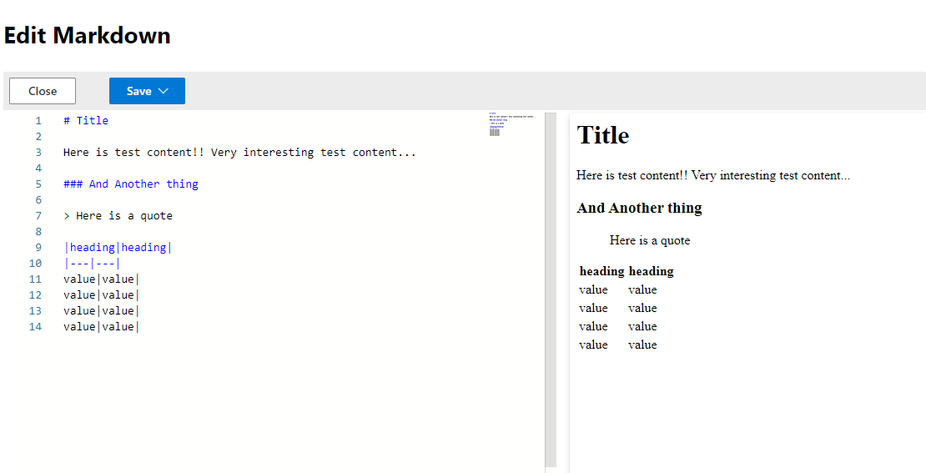
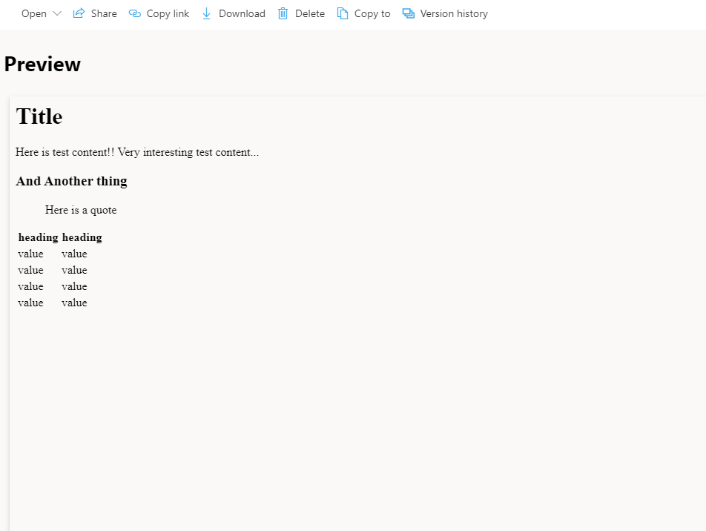
File handlers
Enabling custom file experiences for your file types
File preview
Create new files in the browser
Rich view/edit capability
Custom actions that launch into your app
Customized file icons
Resources
Documentation
Custom file handler sample

Slide 22
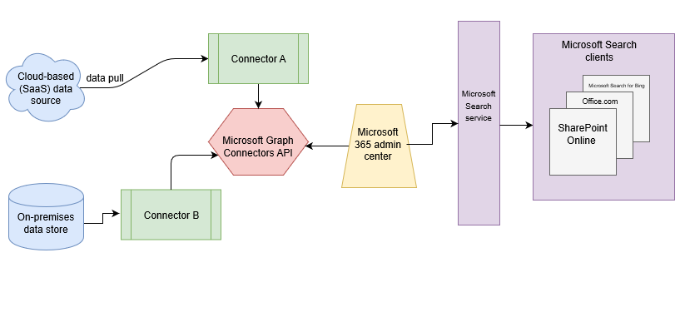
Graph Connector (preview)
Enables ISV/third party specific data to appear in Microsoft Search results
Index your file data
6 Microsoft built connectors – 100+ 3rd party connectors
Resources
Documentation
Microsoft Graph Connector gallery
Graph connector dotnet sample

Slide 23
List extensibility scenarios
An overview of the extensibility options when working with lists in SharePoint

Slide 24
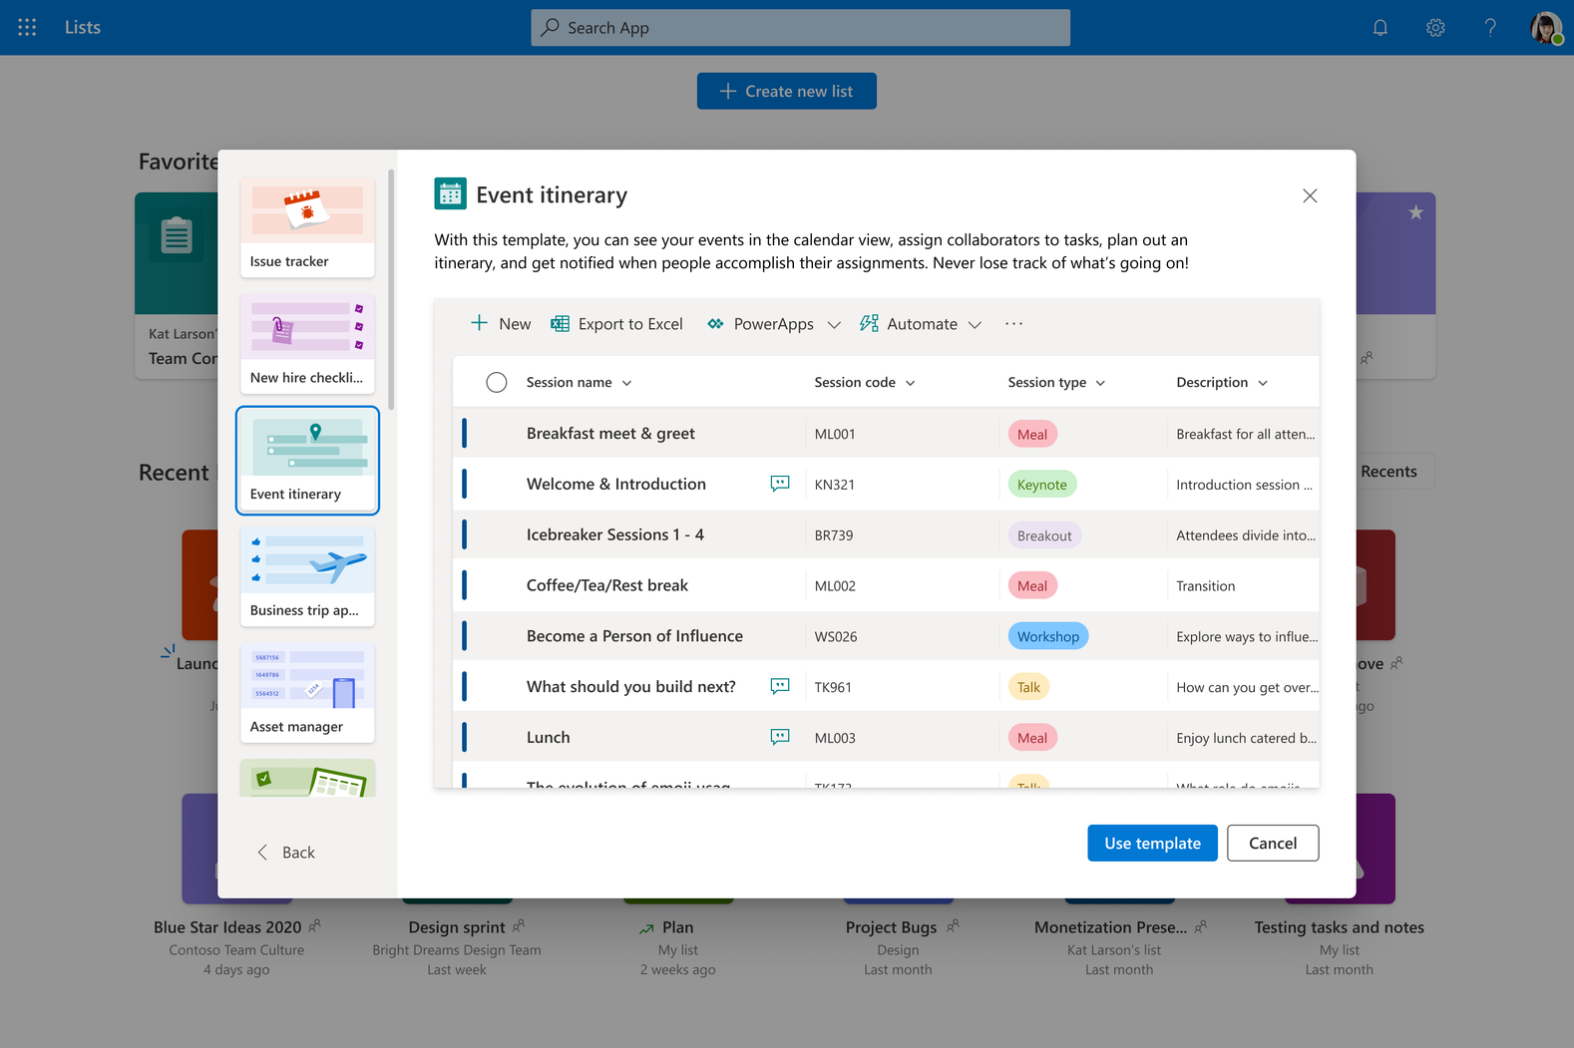
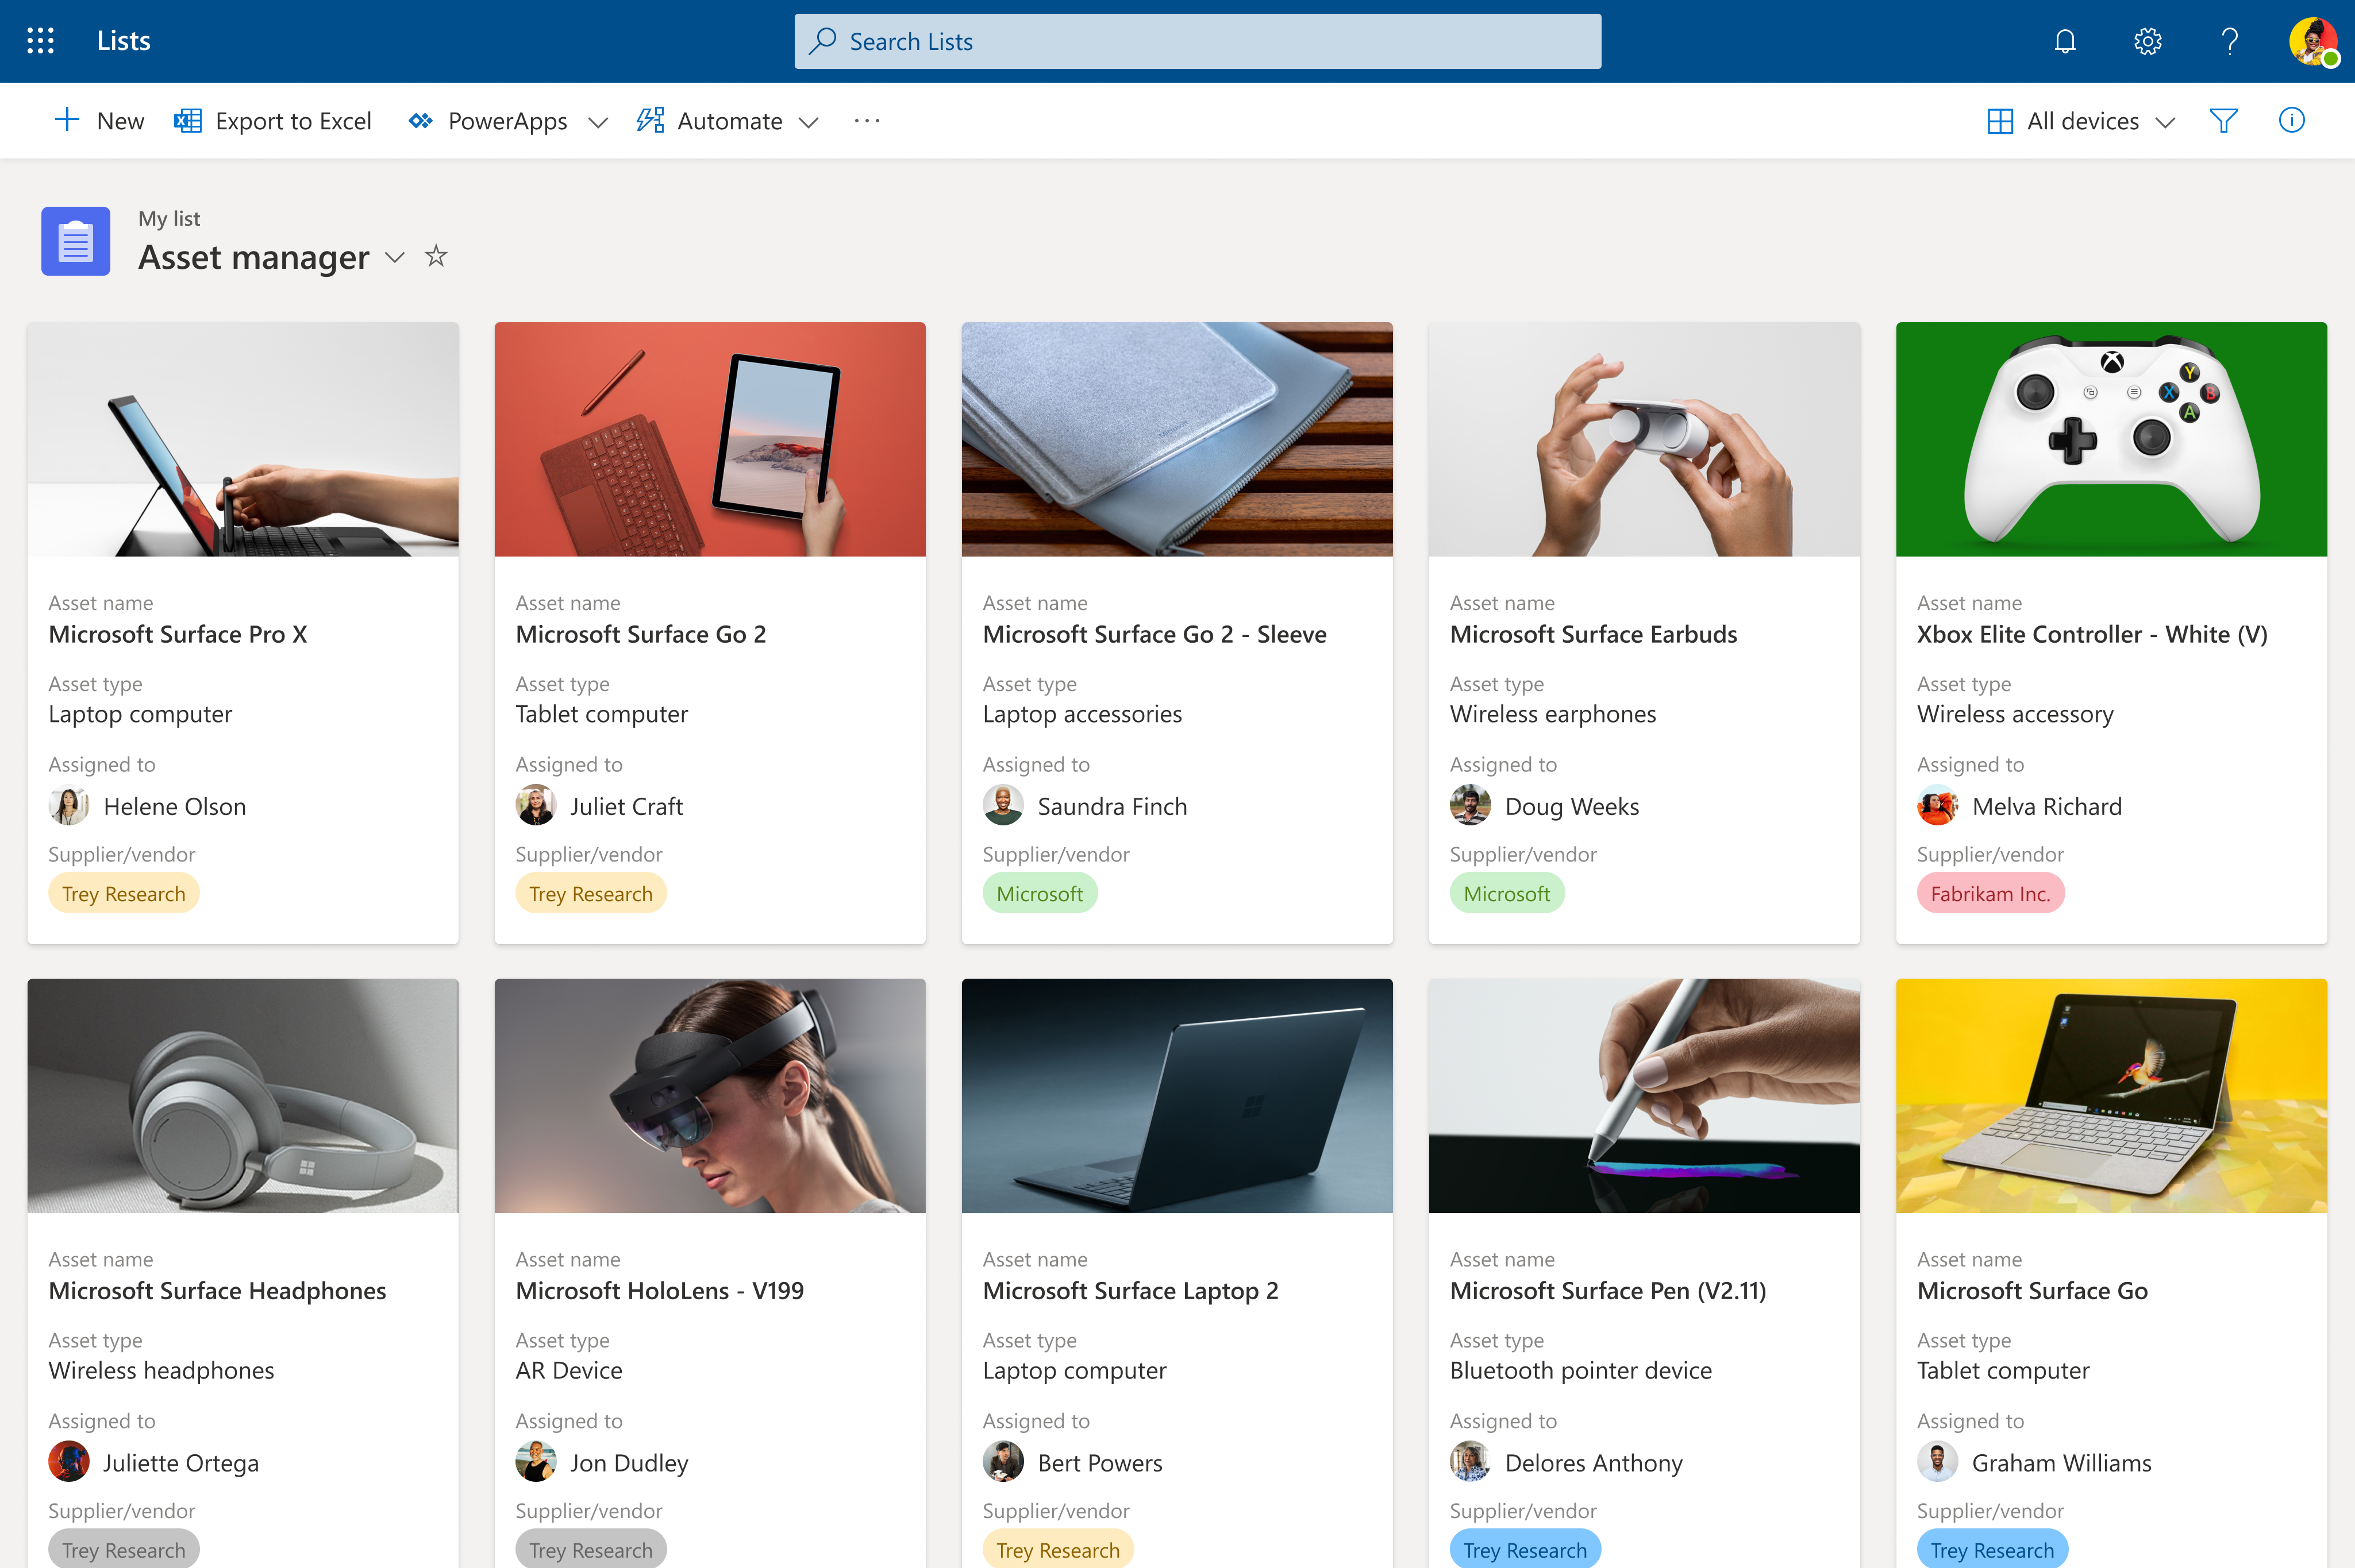
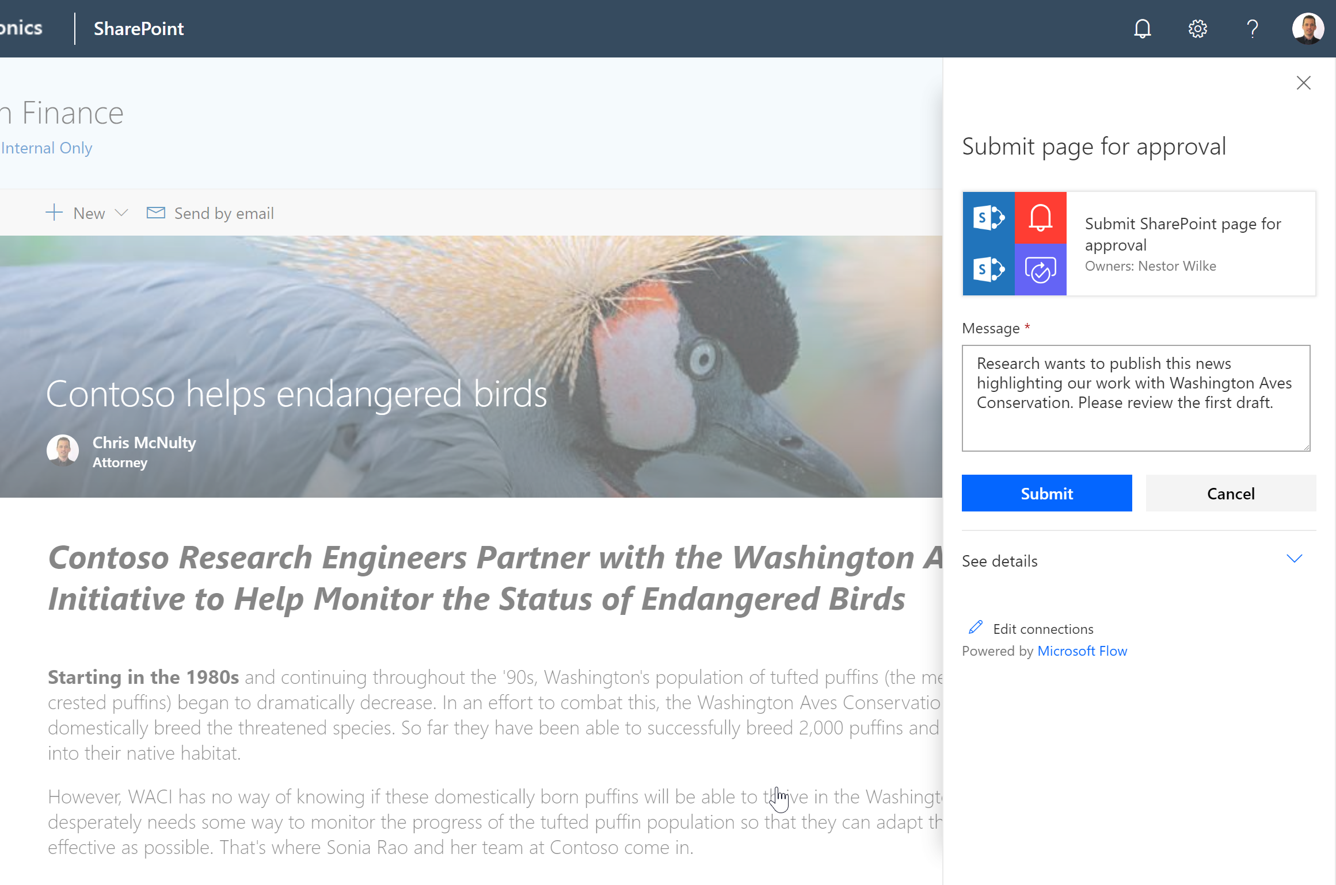
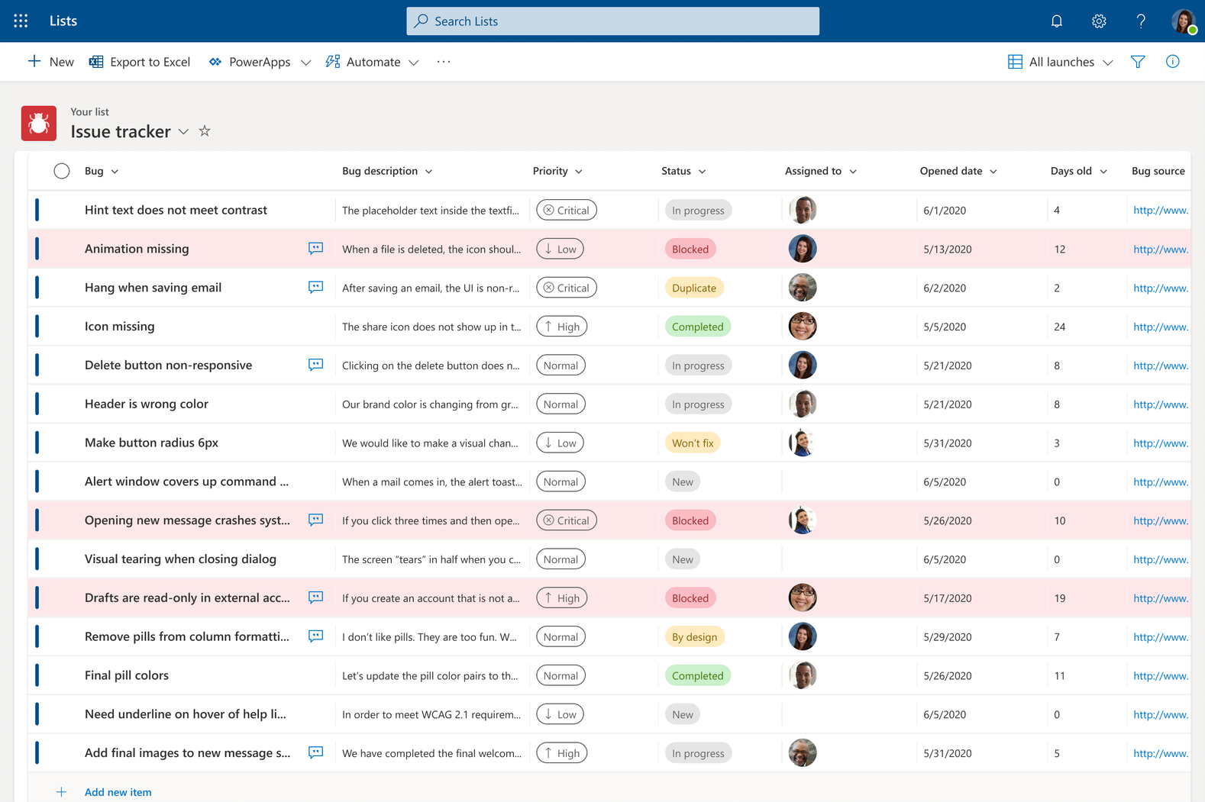
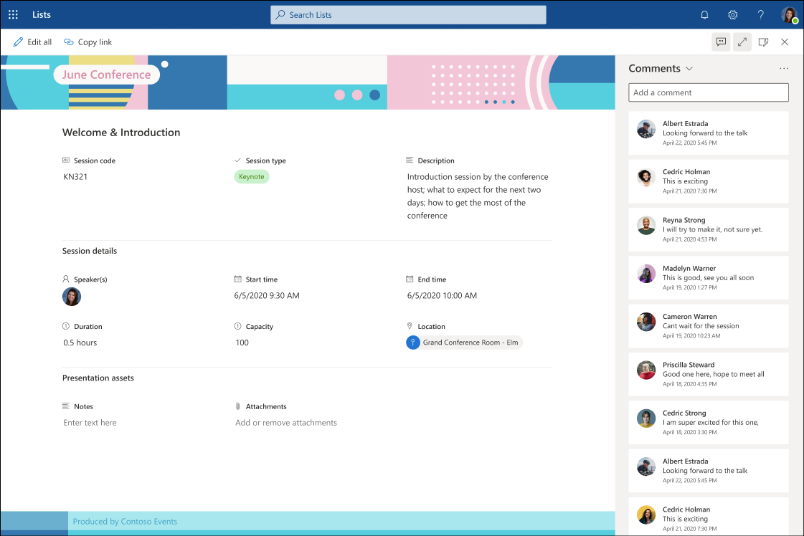
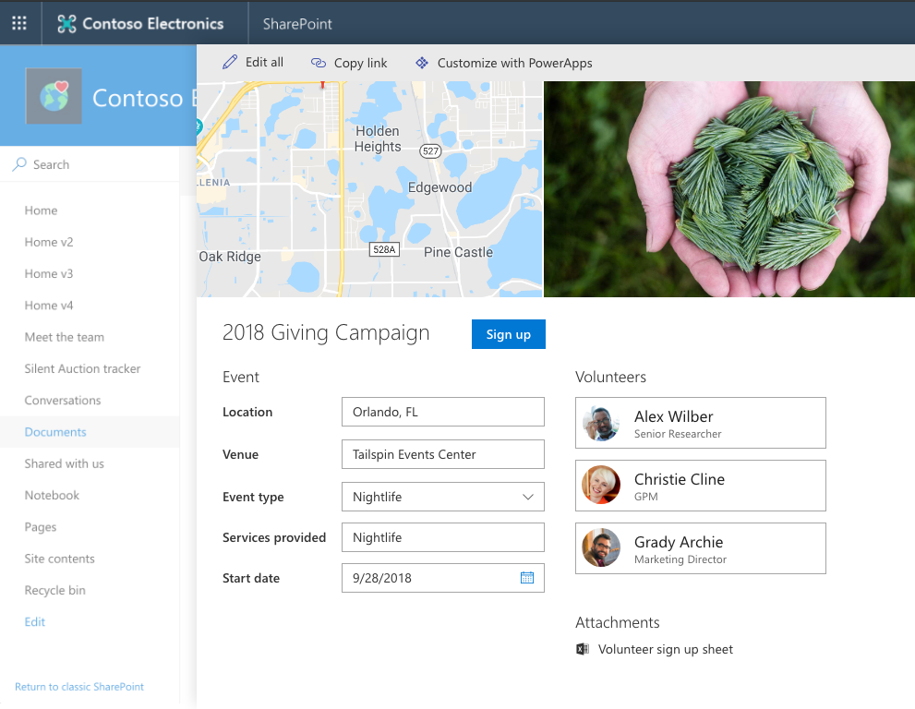
Empowering business processes via Lists
Native Efficiency
Simple Configuration
Integrated Solutions
Collect, manage, and distribute content and data using SharePoint lists and libraries
Lists are the best way to organize the things your team cares about & must get done.
Compose analytics, user experiences, and business processes using an integrated set of services from Microsoft.
Continuum

Slide 25
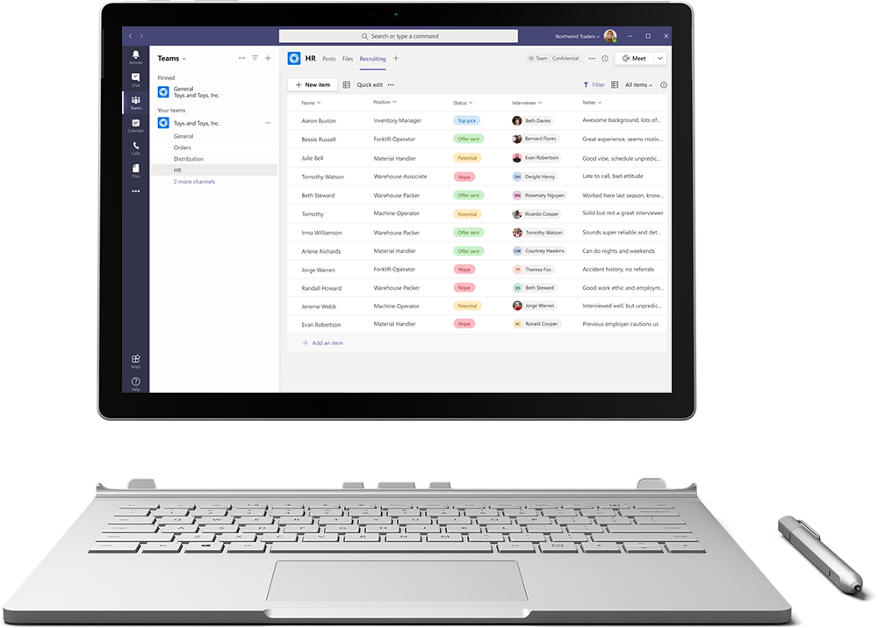
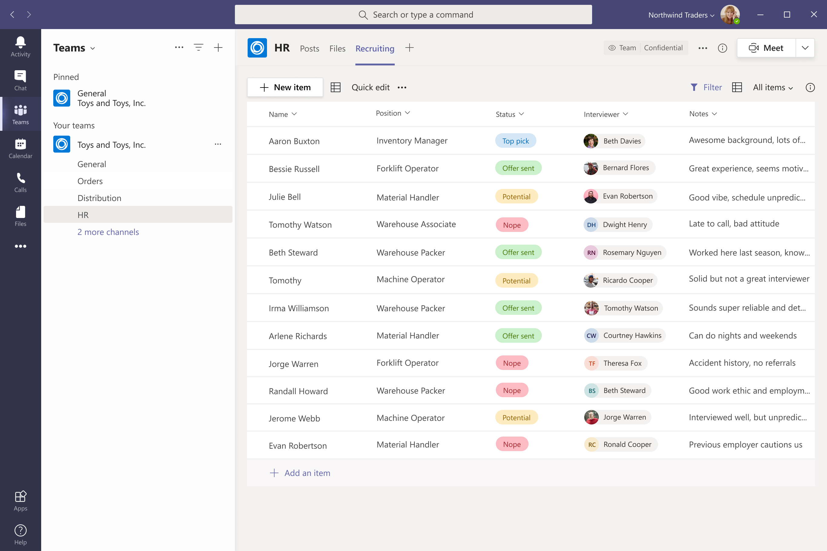

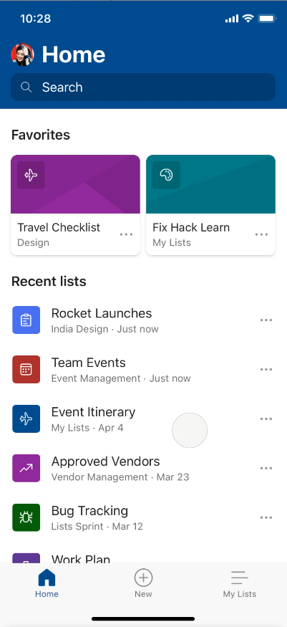
Track what matters most with Microsoft Lists
Simple
Easily create, share, and track lists with anyone, on any device
Smart
Keep everyone in sync with rules and quick edits
Flexible
Customize your lists for whatever your business needs

Slide 26

Simple Configuration
Business Process Automation
Deep integration via API’s

Slide 27
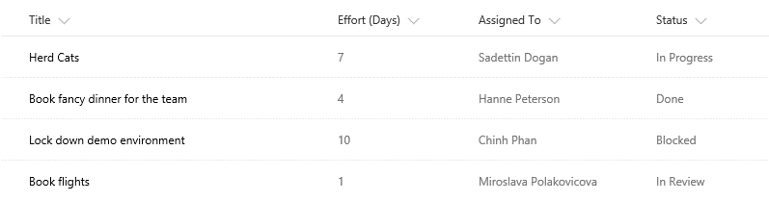
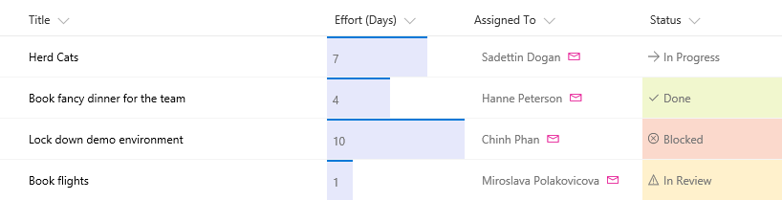
List Formatting : Columns
Use JSON to control how a column is displayed
Out of the box designers available for power users
Include formatting when you provision lists
For more advanced scenarios involving custom code checkout SPFX Field Customizers
Resources
Documentation
List formatting samples

Slide 28
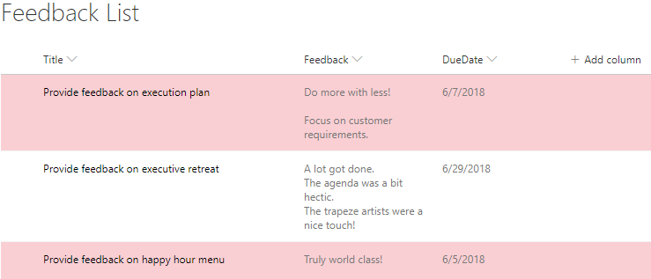
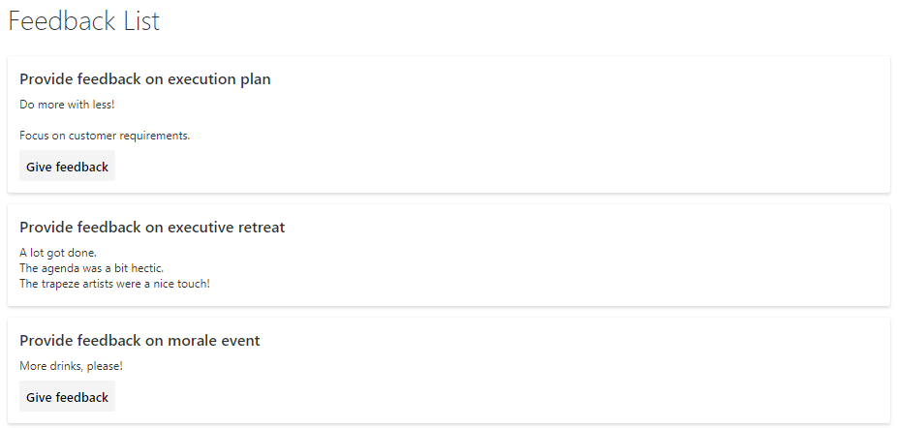
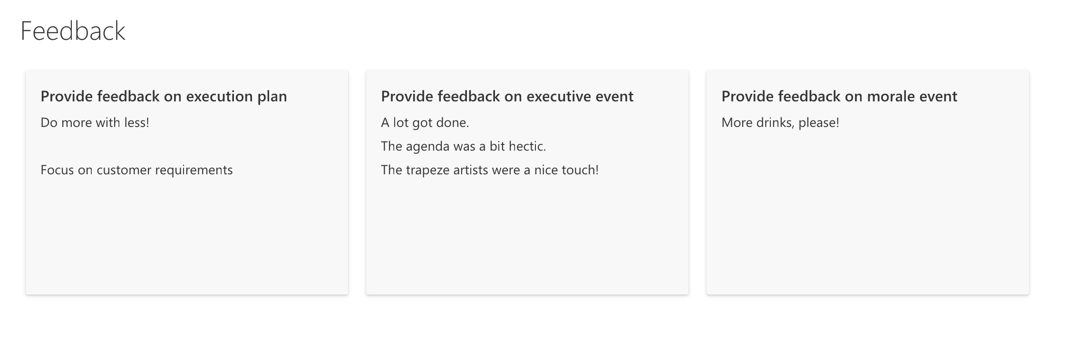
List Formatting : Views
Use JSON to control how a view is presented
Out of the box designers available for power users
Include formatting when you provision lists
Resources
Documentation
List formatting samples

Slide 29
List form configuration
Configure how a list edit/view form is shown
Show, hide and reorder columns
Conditional Show/Hide columns
Resources
Documentation

Slide 30
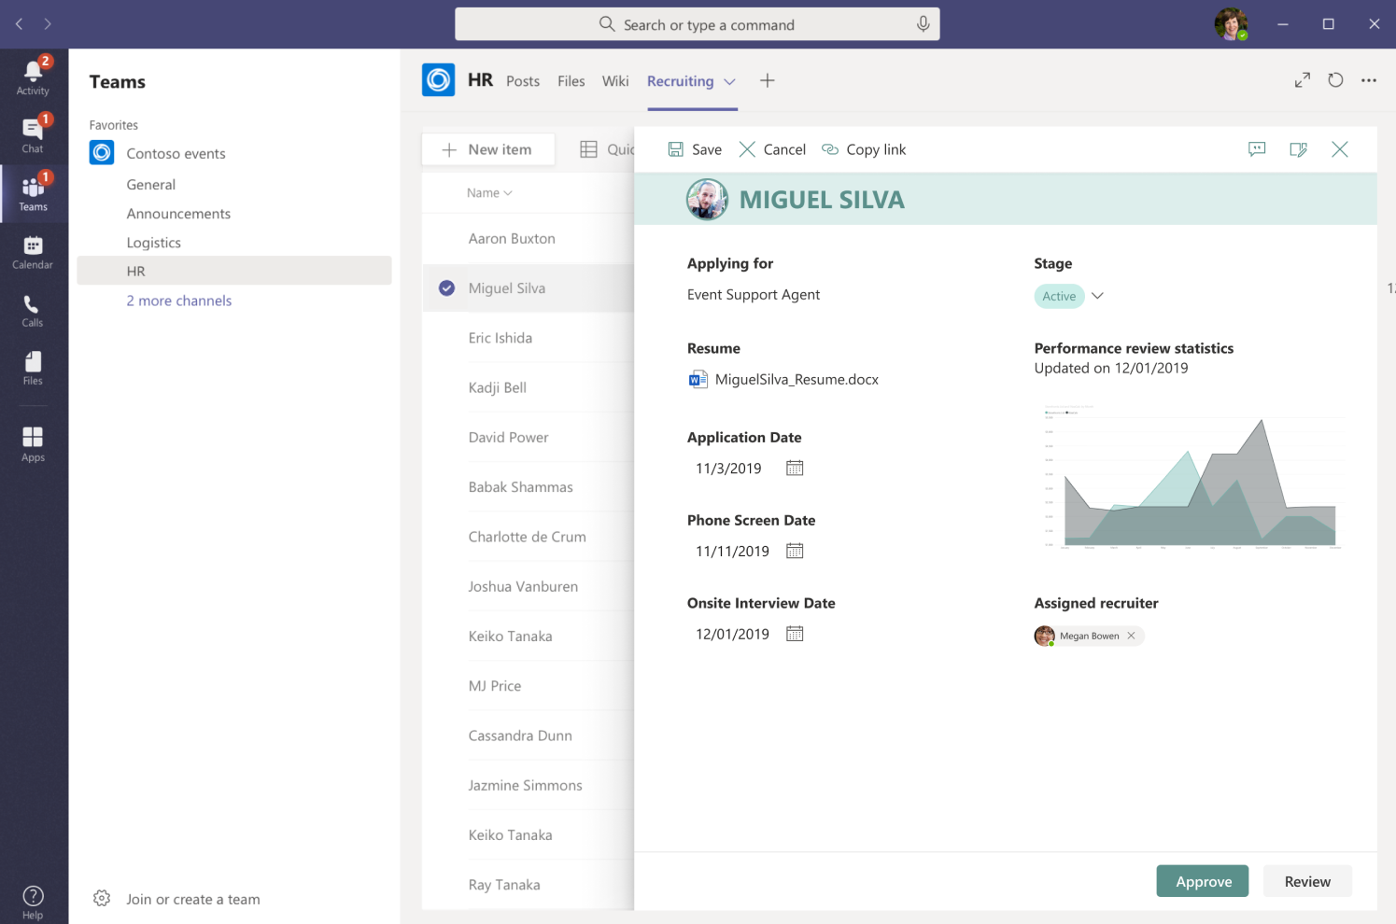
Power Apps integration
Customize your lists and library forms using Power Apps platform.
Resources
Microsoft Lists Resource Center
Documentation

Slide 31
Simple Configuration
Business Process Automation
Deep integration via API’s

Slide 32
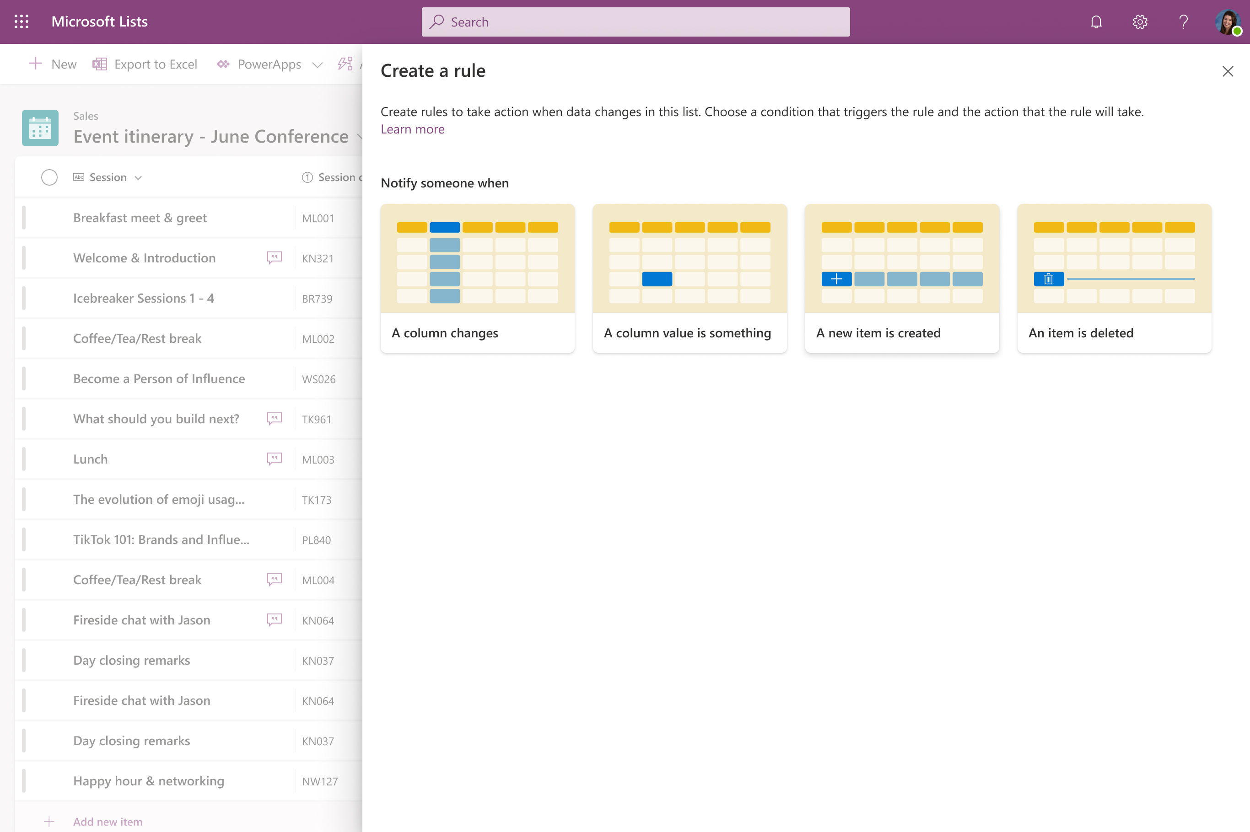
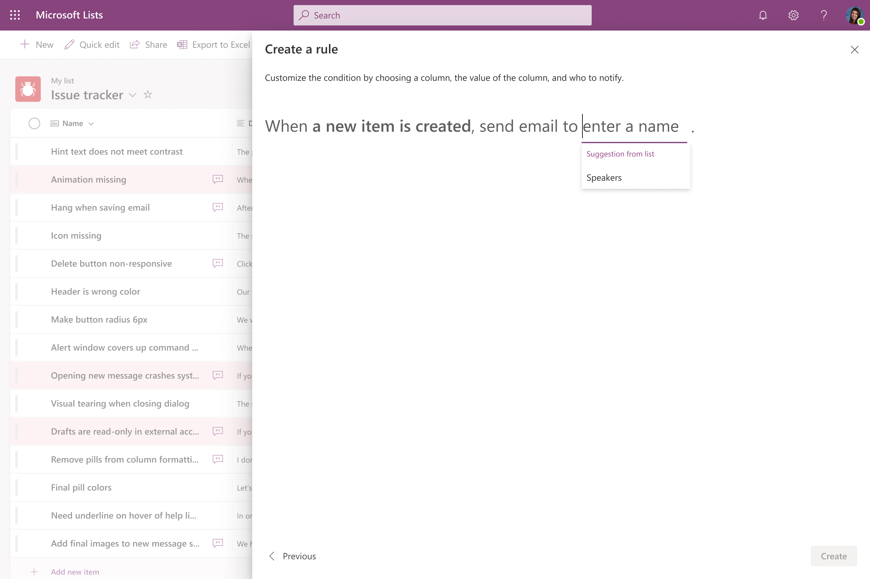
List rules
Trigger a notification based upon rules. Notify someone when
A column changes
A column value changes
A new item is created
An item is deleted
Resources
Microsoft Lists Resource Center
Coming soon!

Slide 33
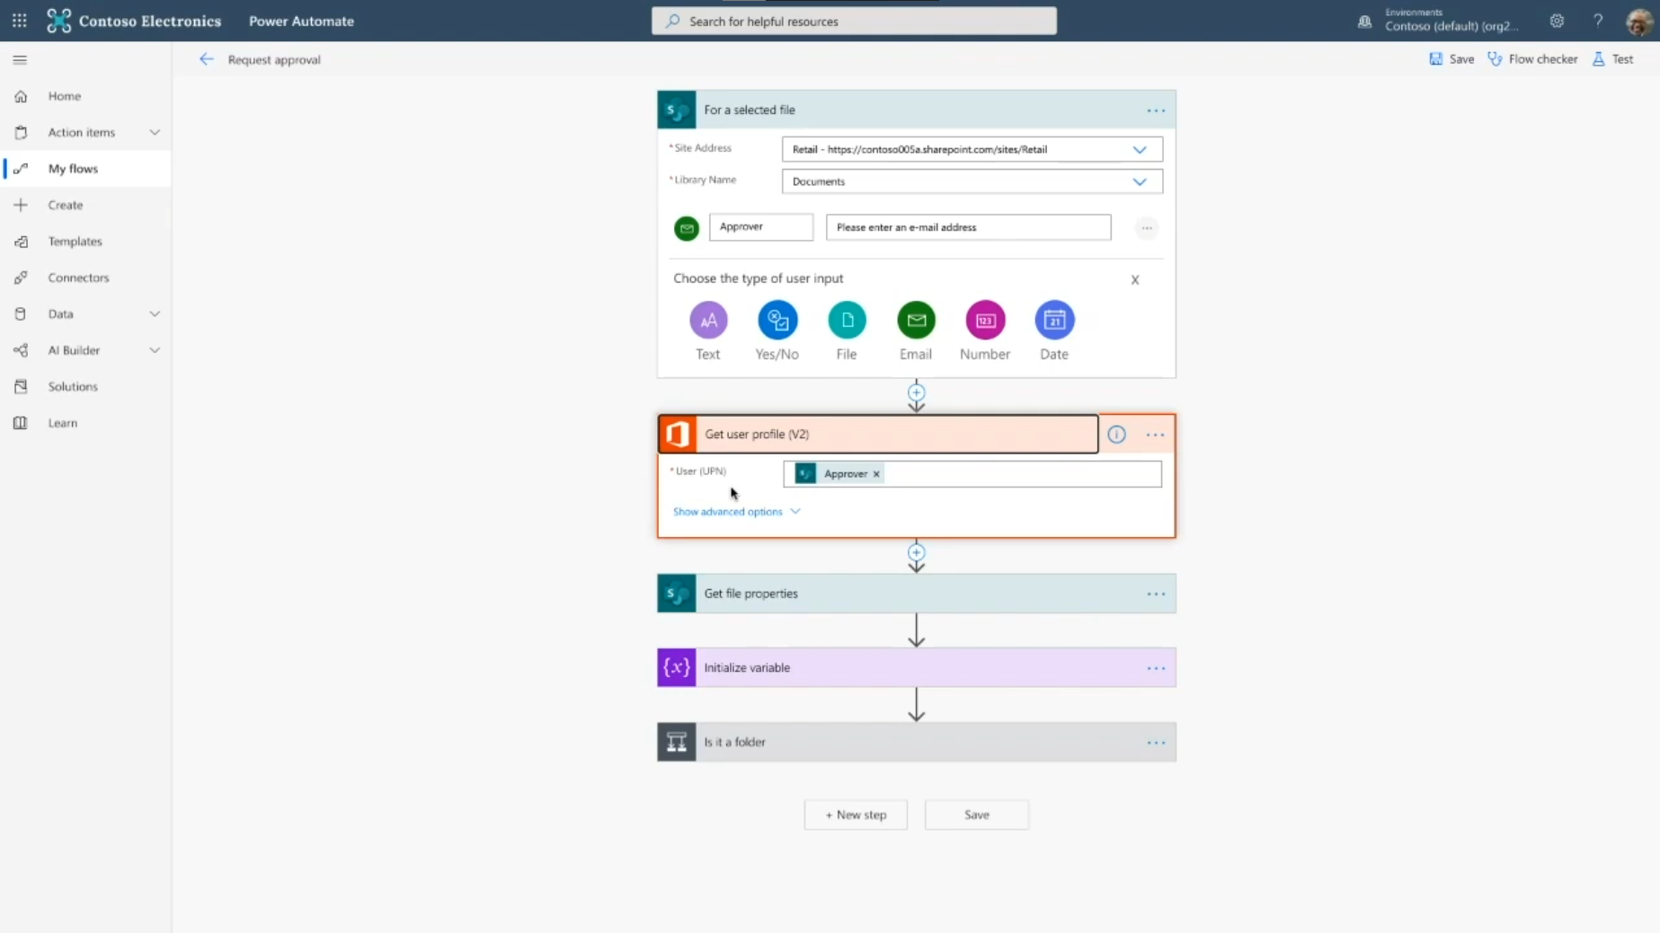
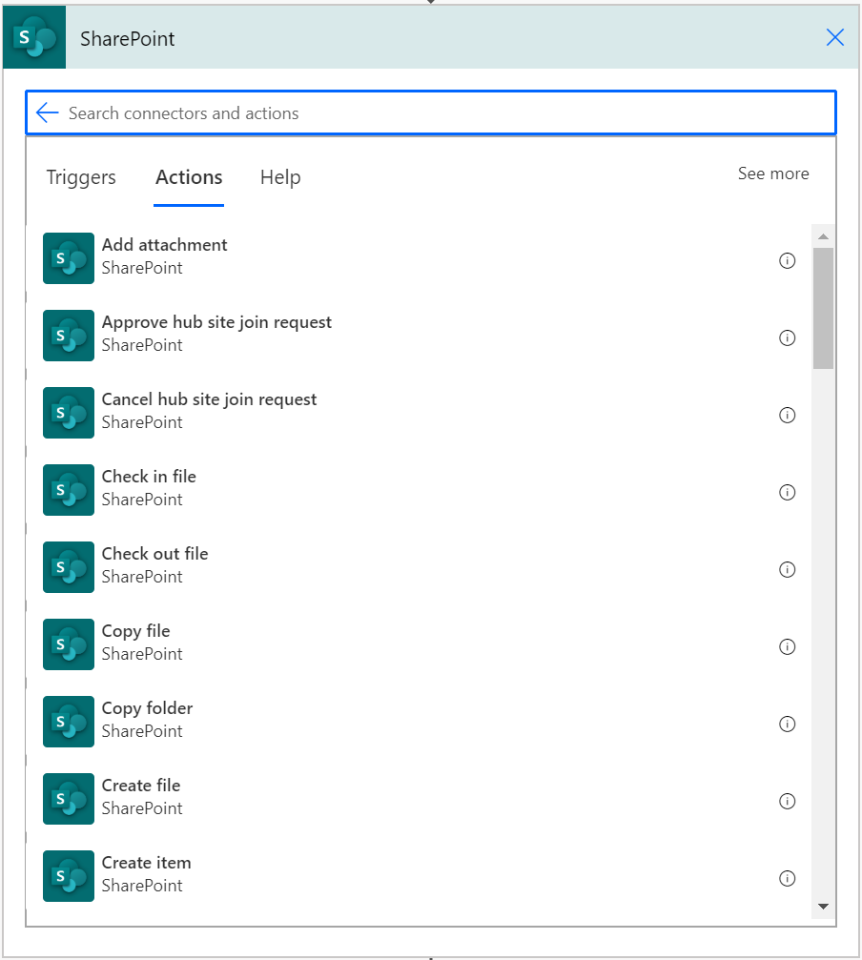
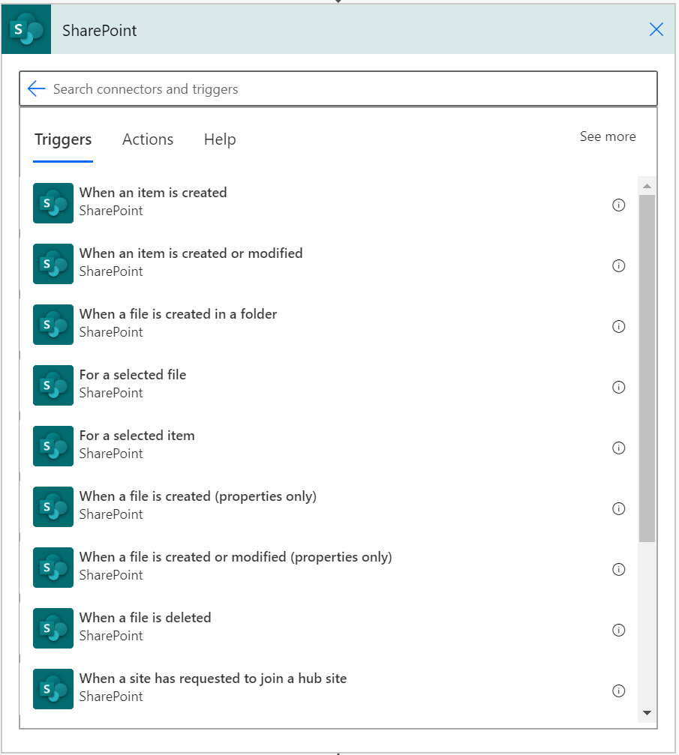
Power Automate integration
Enable business processes on top of lists & libraries via the SharePoint Connector
Reminders on date columns
Sign-off, content and page approvals
Your custom business process
Resources
Microsoft Lists Resource Center
SharePoint Power Automate Connector

Slide 34
Simple Configuration
Business Process Automation
Deep integration via API’s

Slide 35
Basic Microsoft Graph elements
Sites – Contains lists, drives, and subsites
/v1.0/sites/{site-id}
List – Contains items, column definitions and content types
ListItem – The item data for the item in a list
/v1.0/sites/{site-id}lists/{list-id}/items/{item-id}

Slide 36
SharePoint Framework
Using SharePoint Framework (SPFX) to extend and enrich the SharePoint user experience

Slide 37
What is SharePoint Framework?
“An application framework used to build and extend modern experiences in SharePoint and in Microsoft Teams”
Microsoft Graph
Extension header
Application pages
Custom tabs
Web parts
Personal apps
Page visuals Office UI Fabric
Task modules
Extension footer
SPFx was publicly announced May 4th, 2016

Slide 38
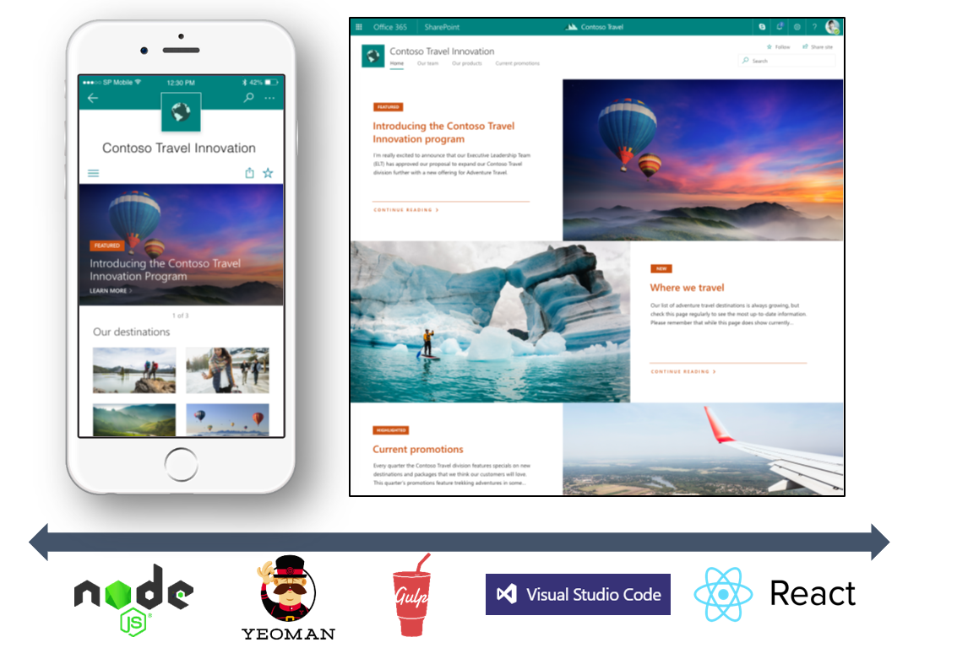
SharePoint Framework (SPFX)
Modern client-side development
Lightweight web and mobile
Powers our own experiences
Backward compatible
Supports open source tools and JavaScript web frameworks
SharePoint Framework
Microsoft Graph
LOB Systems and Cloud Services
https://aka.ms/spfx-tutorials

Slide 39
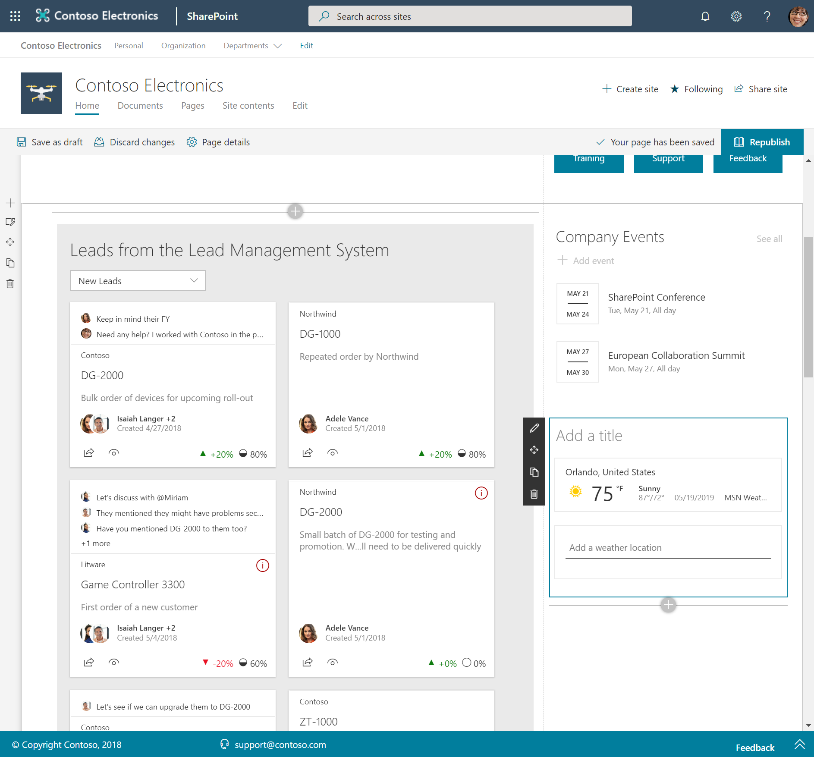
Web parts
Controls that appear inside a SharePoint page and execute client-side in the browser
Resources
aka.ms/spfx
Develop web parts with the SharePoint Framework
SharePoint Framework Client-Side Web Part Samples & Tutorial Materials

Slide 40
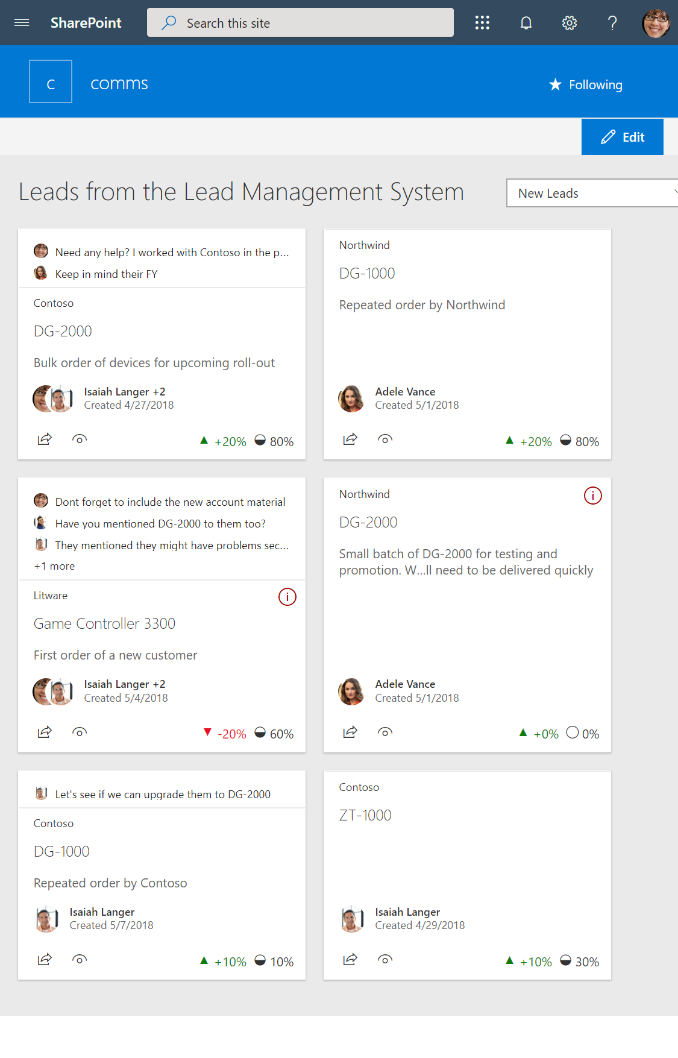
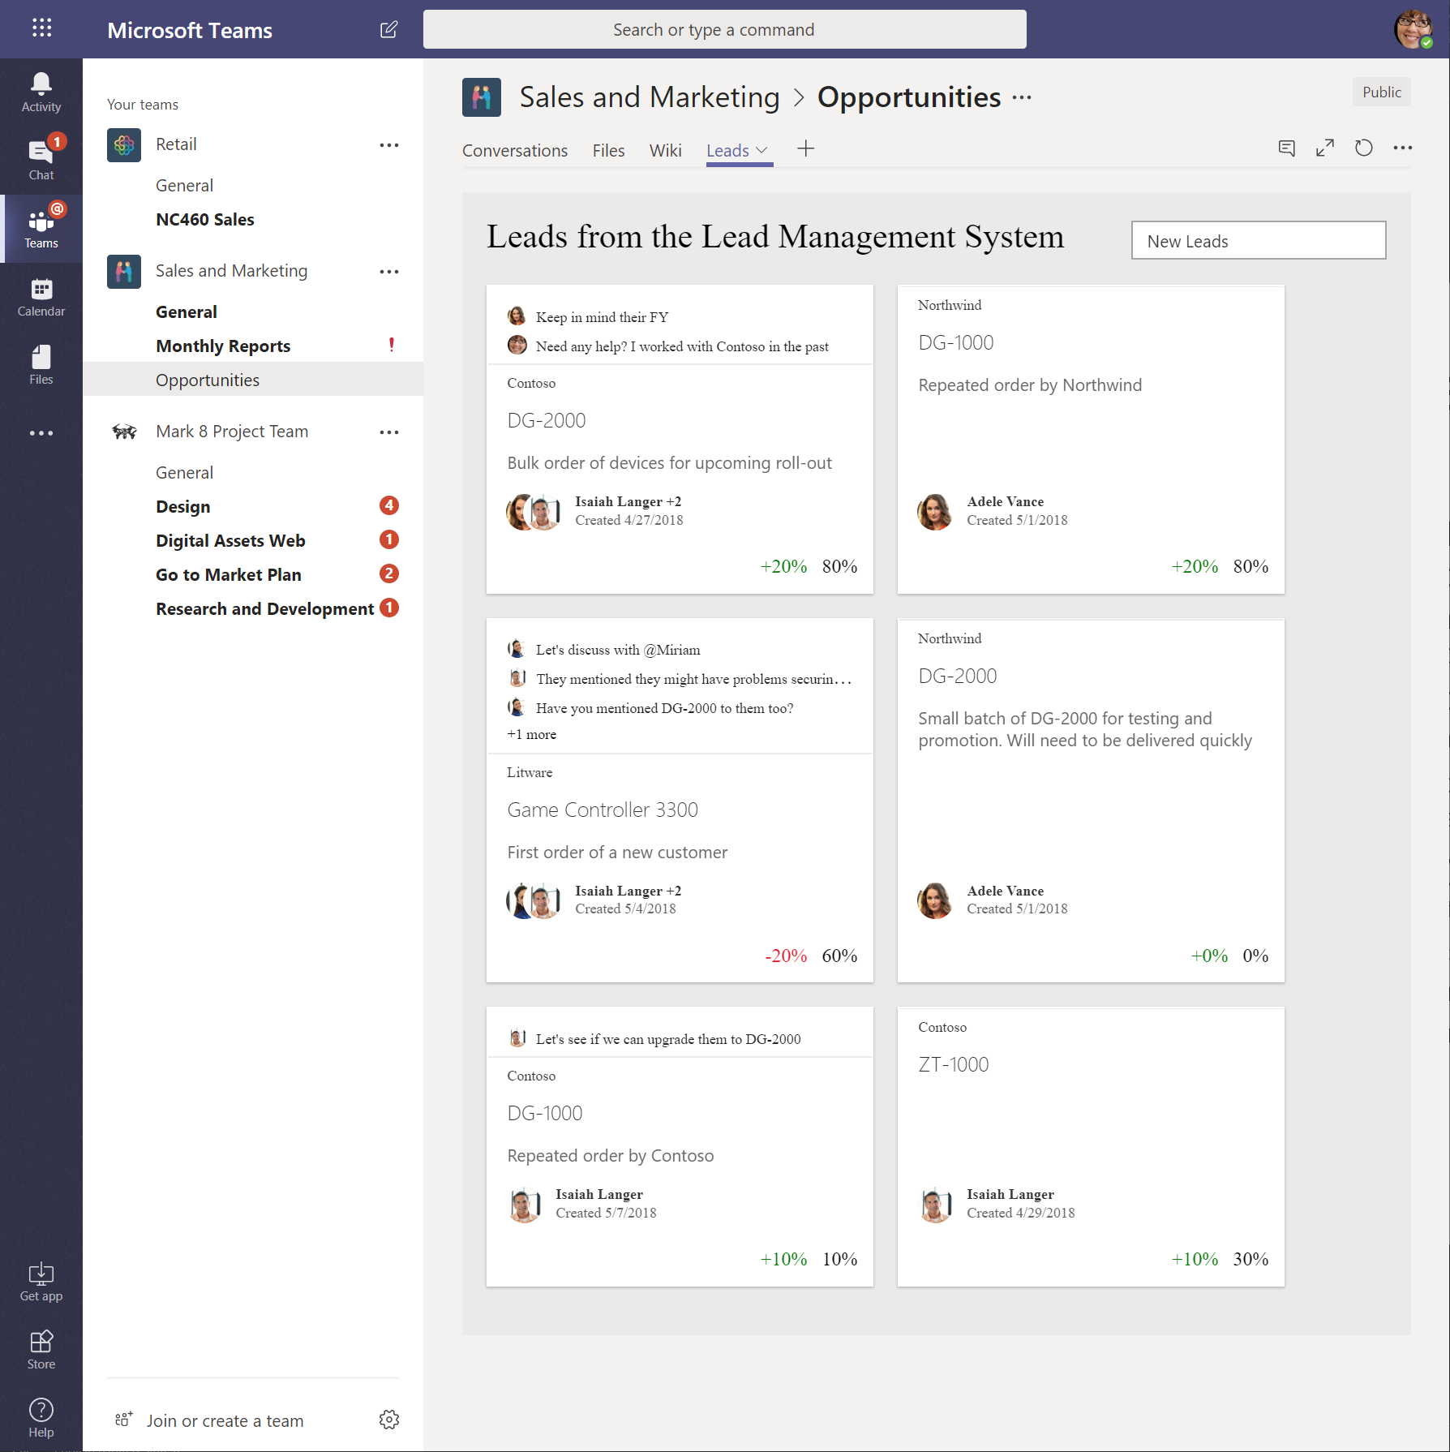
Use Web Parts across services
Web Parts
App pages
Teams Tabs

Slide 41
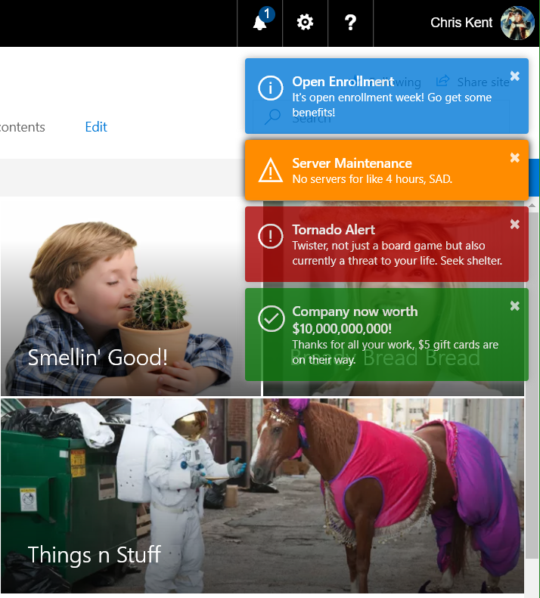
Application Customizers
Adds scripts to the page, and accesses well-known HTML element placeholders and extends them with custom renderings
Resources
aka.ms/spfx
Extend the SharePoint user interface with SharePoint Framework extensions
SharePoint Framework Extensions Samples & Tutorial Materials

Slide 42
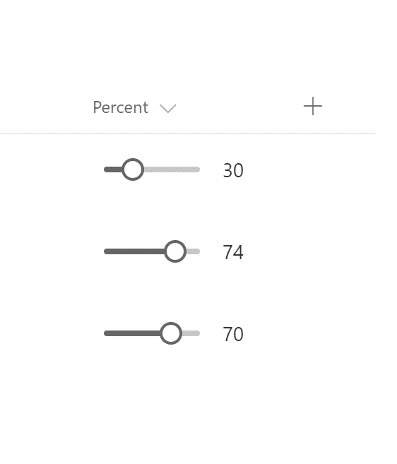
Field Customizers
Provides modified views to data for fields within a list
Resources
aka.ms/spfx
Extend the SharePoint user interface with SharePoint Framework extensions
SharePoint Framework Extensions Samples & Tutorial Materials

Slide 43
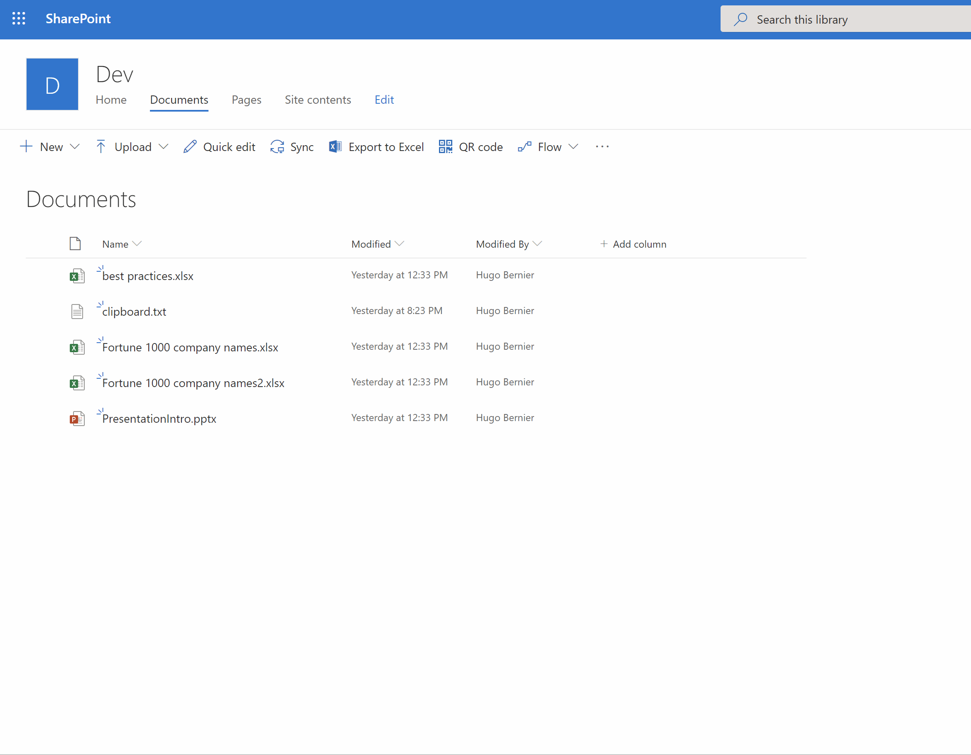
Command Sets
Extends the SharePoint command surfaces to add new actions, and provides client-side code that you can use to implement behaviors
Resources
aka.ms/spfx
Extend the SharePoint user interface with SharePoint Framework extensions
SharePoint Framework Extensions Samples & Tutorial Materials

Slide 44
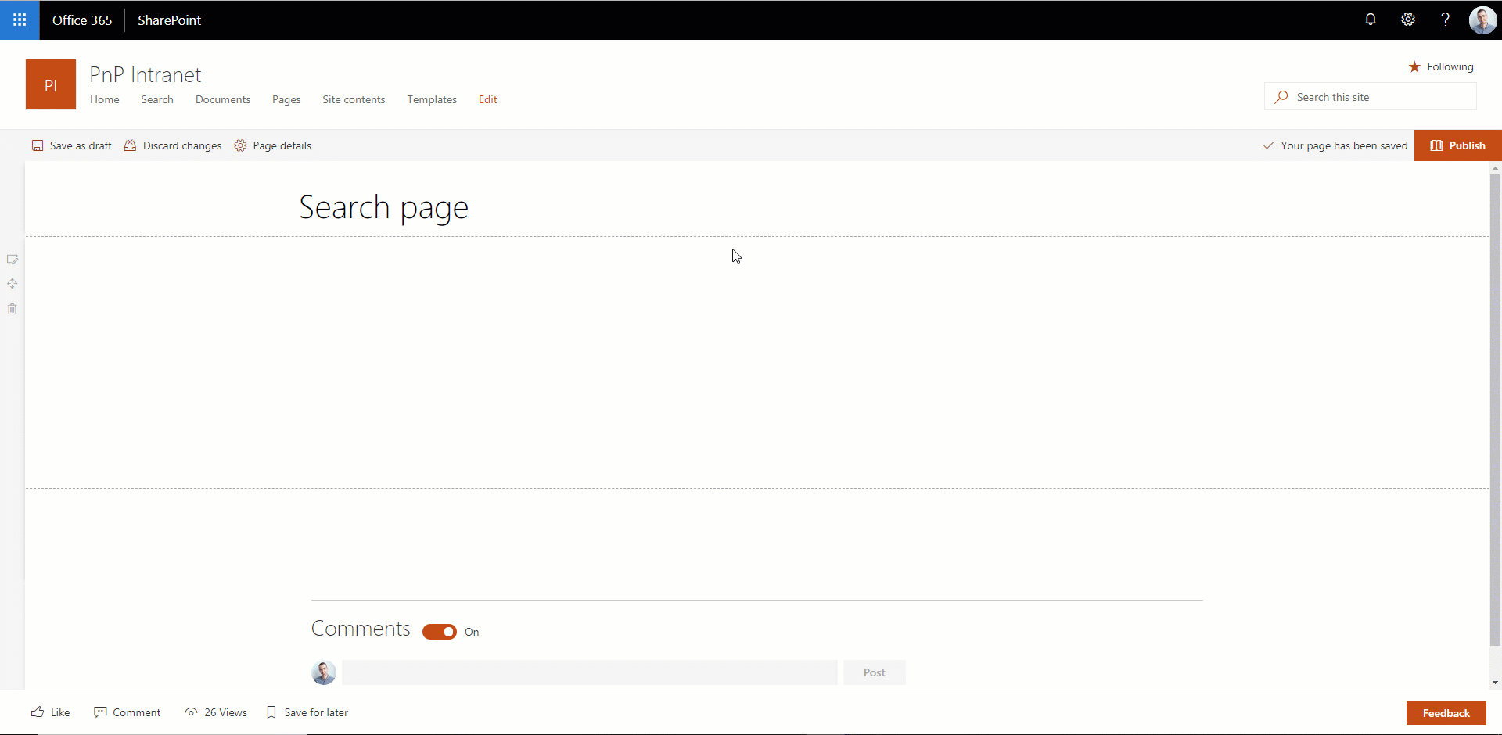
Search Query Extension
Allows you to manipulate the user's search query before it is sent to SharePoint
Resources
aka.ms/spfx
PnP Modern Search
Getting started with Search Query extensions

Slide 45
Deployment and Configuration
Take control over how users create sites, make your apps available to the SharePoint users

Slide 46





App deployment options
Site A
Site Apps
AppSource (public)
My private app 1
My public app
My public app
Site A
Site Apps
My private app 1
Tenant App Catalog (private)
My private app 2
My public app
Site A
My private app 1
Site Apps
My private app 2
Site App Catalog
My private app 1
Site private app
Site private app

Slide 47
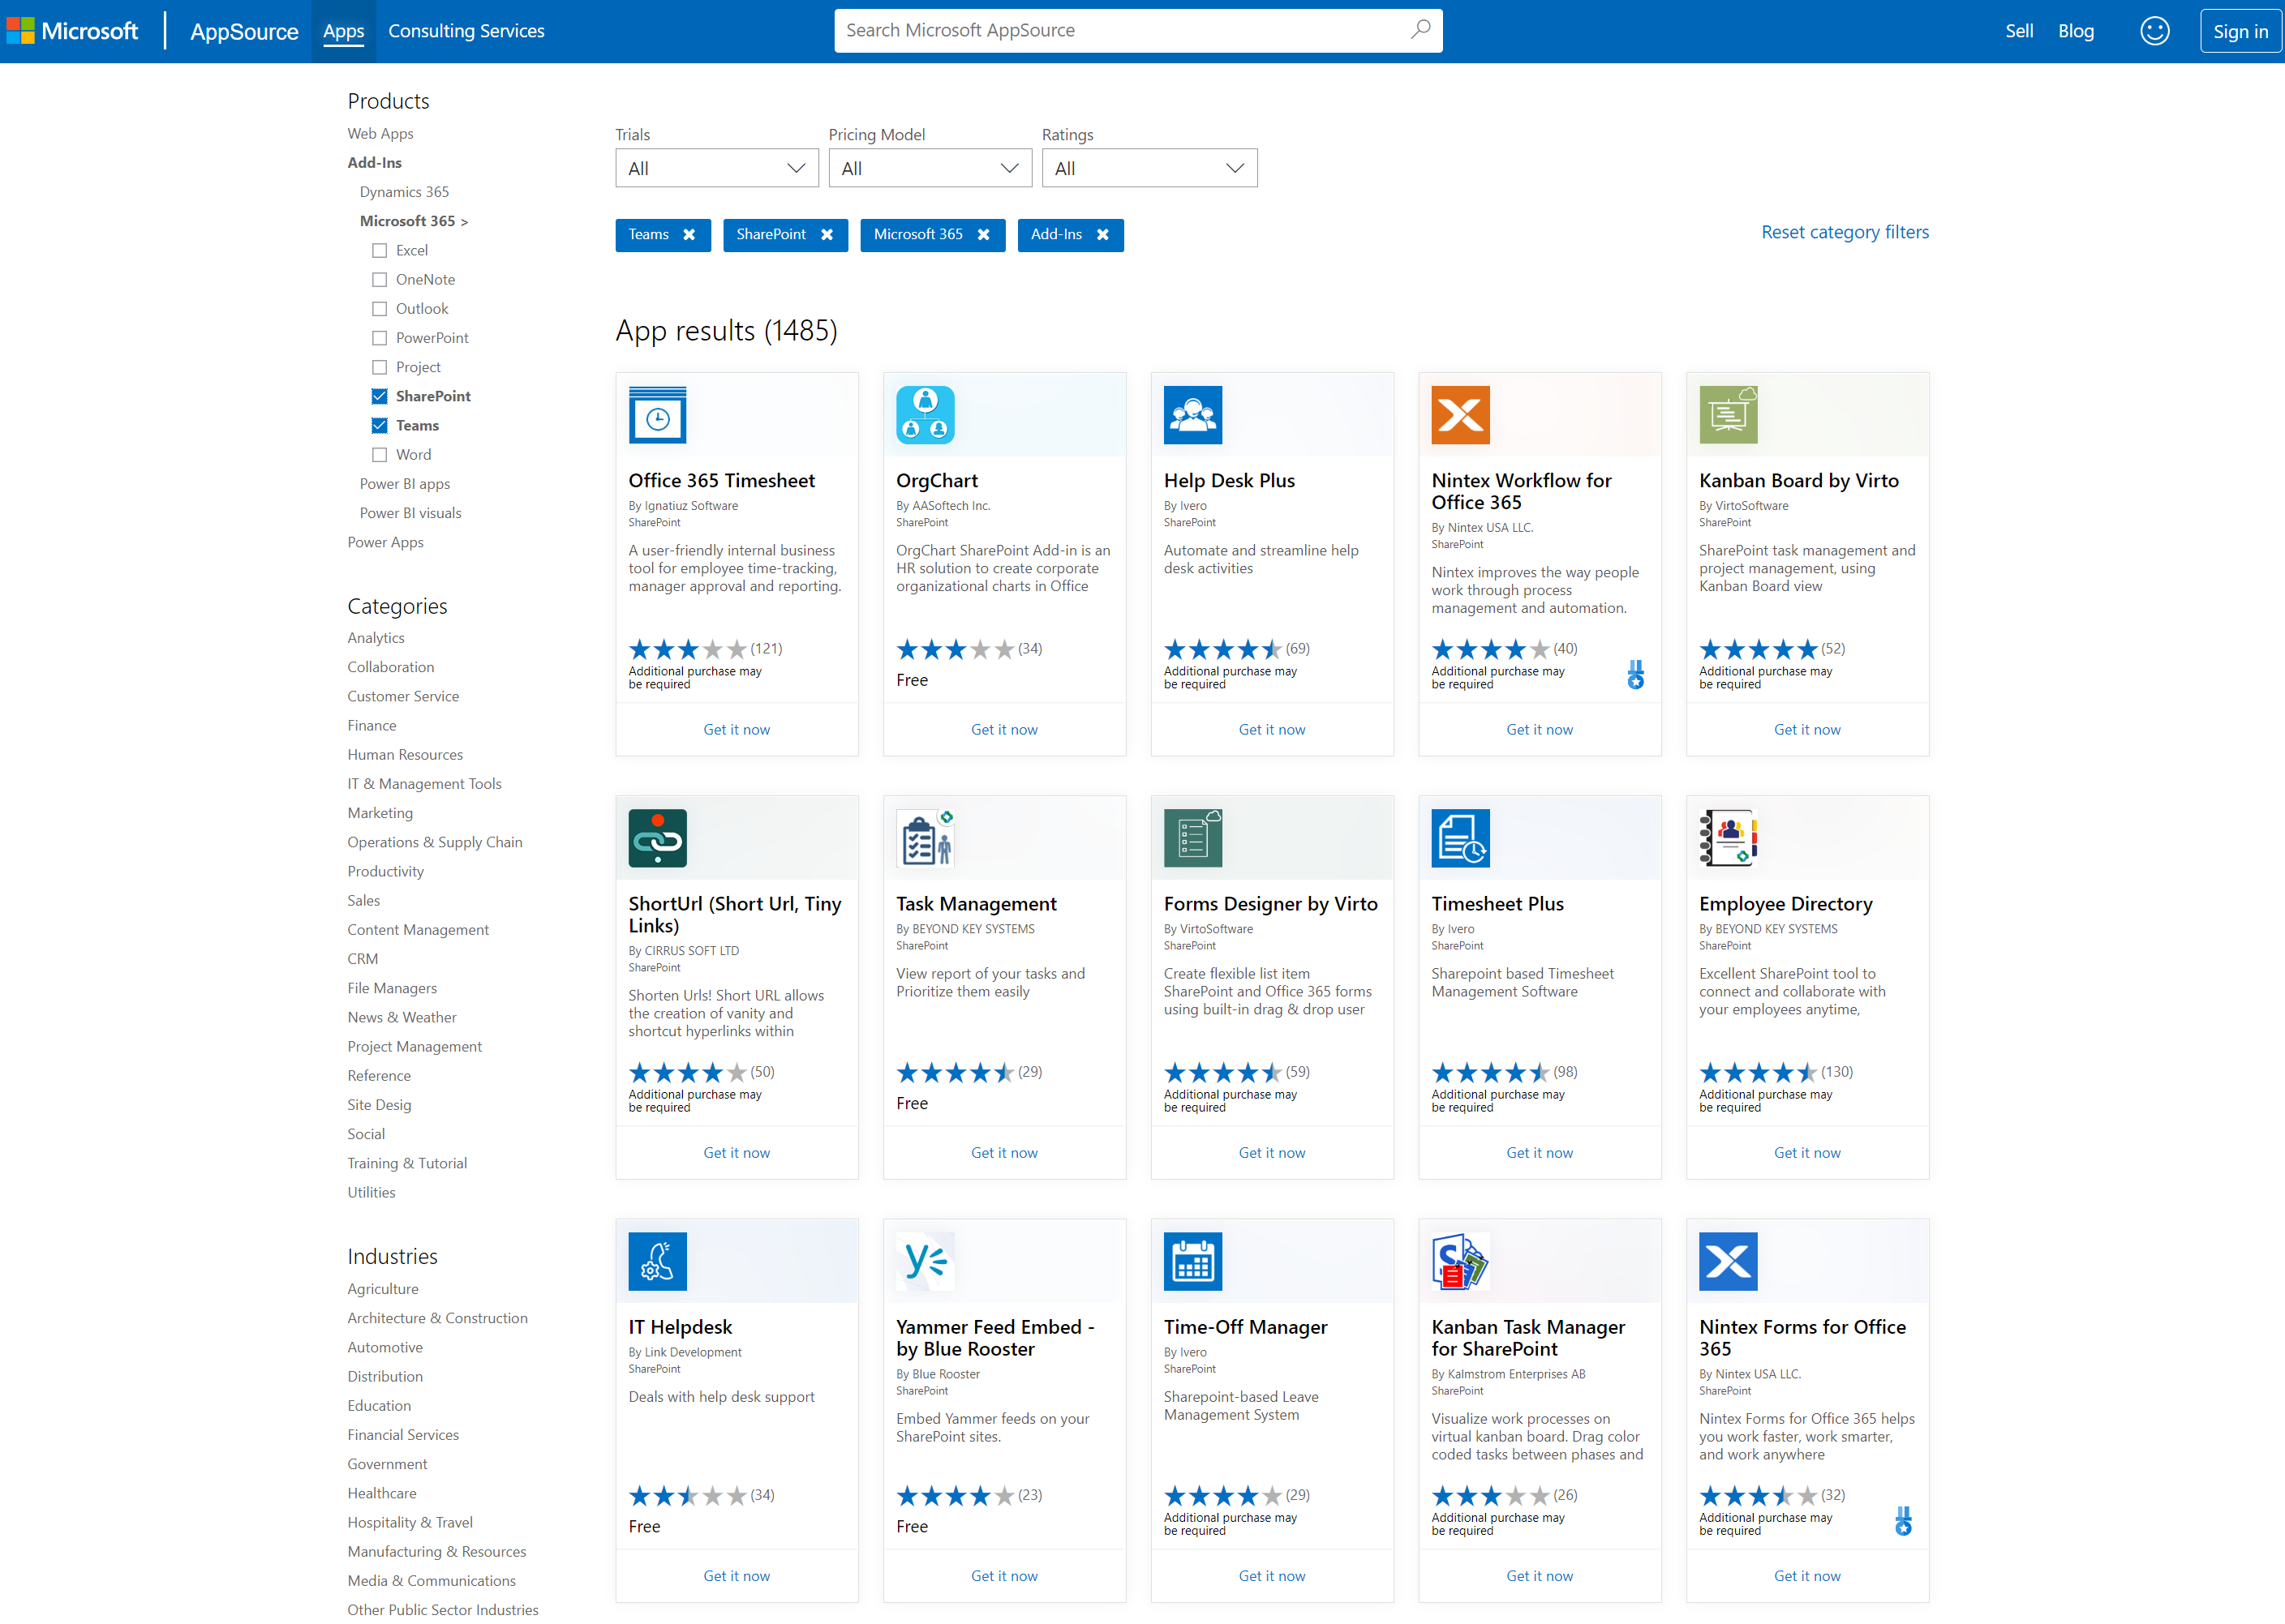
App Source
Public store for SharePoint, Teams and Office apps
Resources
Documentation
https://appsource.microsoft.com/

Slide 48
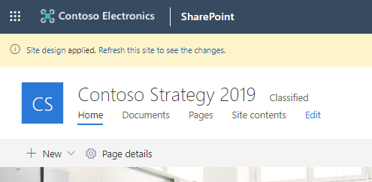
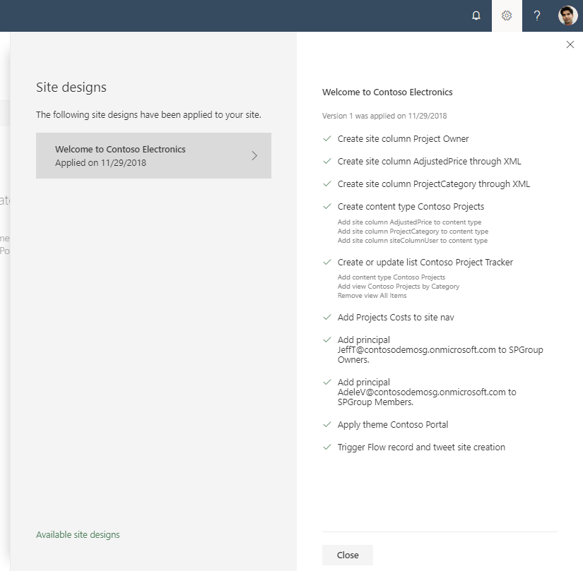
Site Designs and Site Scripts
Automate SharePoint provisioning to new or existing SharePoint
Create SharePoint artefacts such as lists, libraries, content types
Update navigation and apply branding
Configure security
Deploy apps
Trigger Power Automate for custom coded provisioning tasks
Resources
Documentation

Slide 49
Open Source Software
There’s a very vibrant community of Microsoft developers building open source for SharePoint, OneDrive and Microsoft Graph

Slide 50
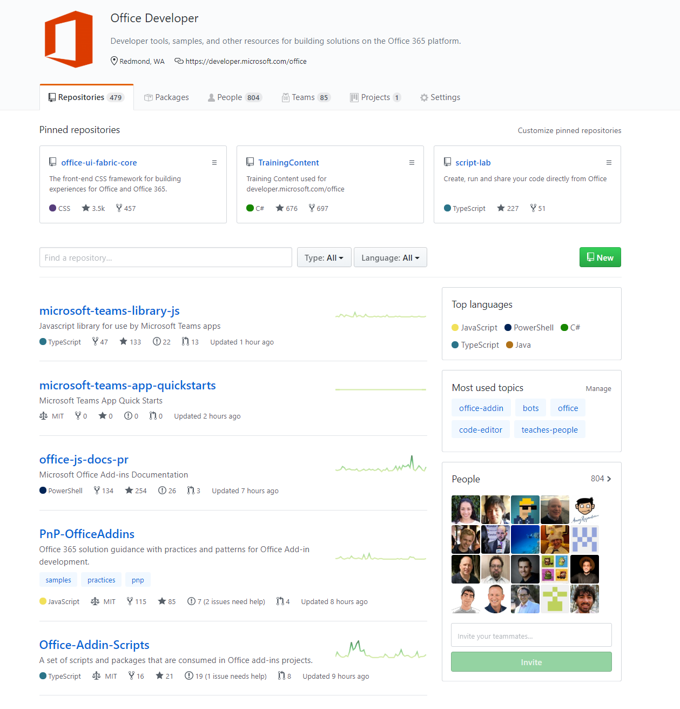
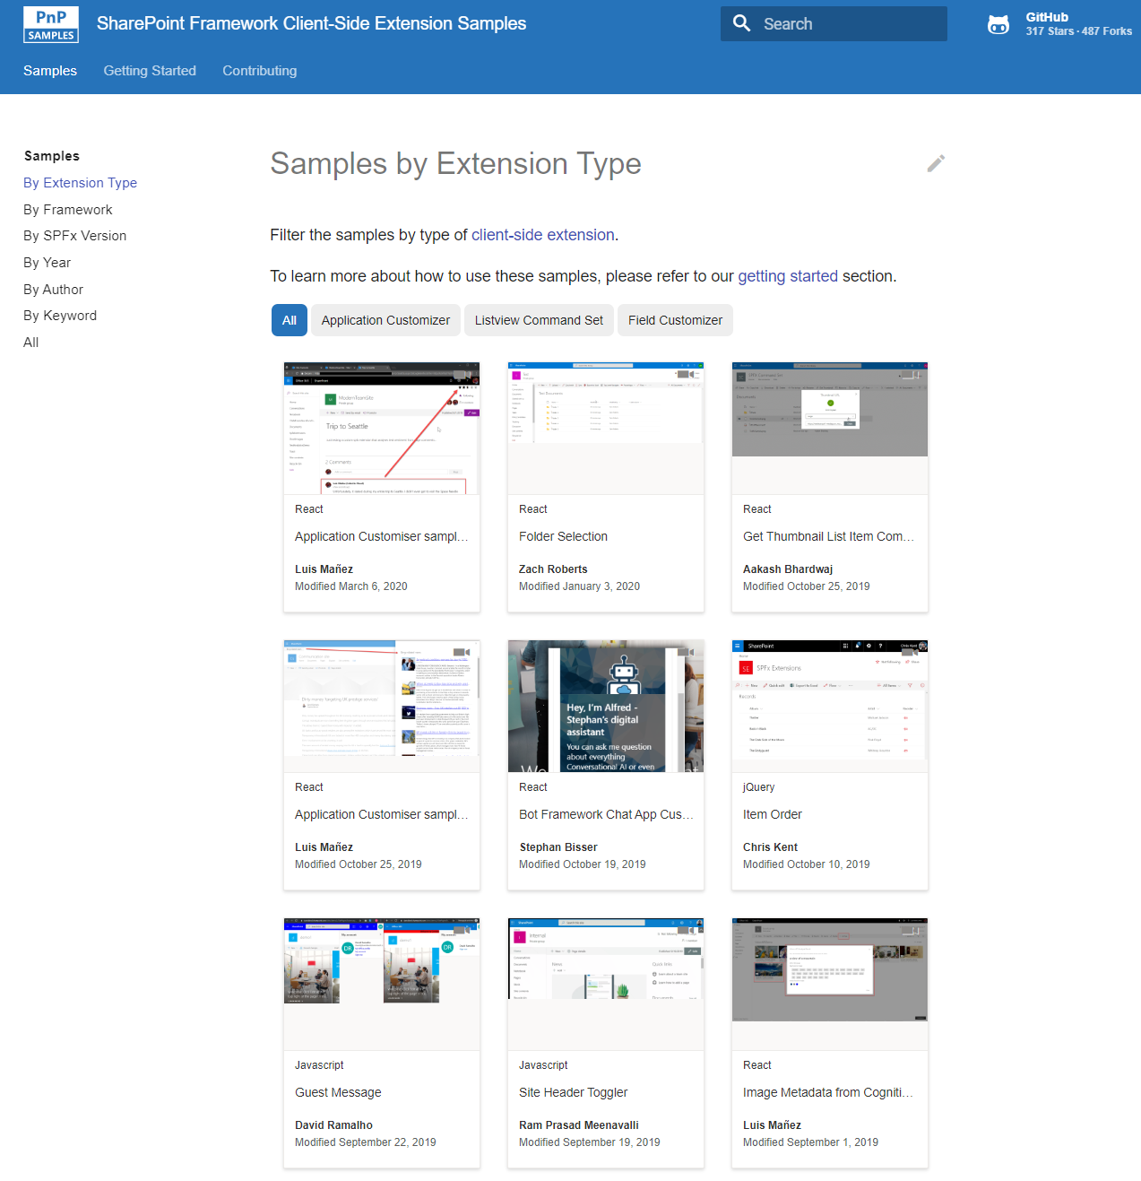






Microsoft 365 developer videos
Microsoft 365 & SharePoint community
(PnP) videos
Open-source
Sample galleries
Initiatives
github.com/sharepoint
github.com/pnp
github.com/officedev
github.com/microsoftgraph
aka.ms/spfx-webparts
aka.ms/spfx-extensions
aka.ms/list-formatting
aka.ms/teams-samples
aka.ms/m365pnp
aka.ms/M365DevYouTube
aka.ms/m365pnp-videos
@Microsoft365Dev | @m365pnp

